Slide 1
Strategic Planning Driving Innovative Measures of Success The University of Massachusetts Lowell

Slide 2
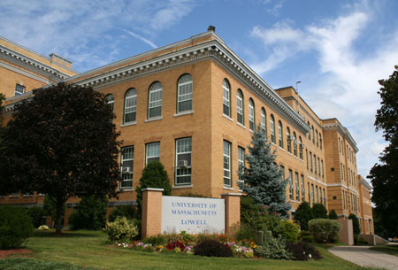
Our Campus

Slide 3
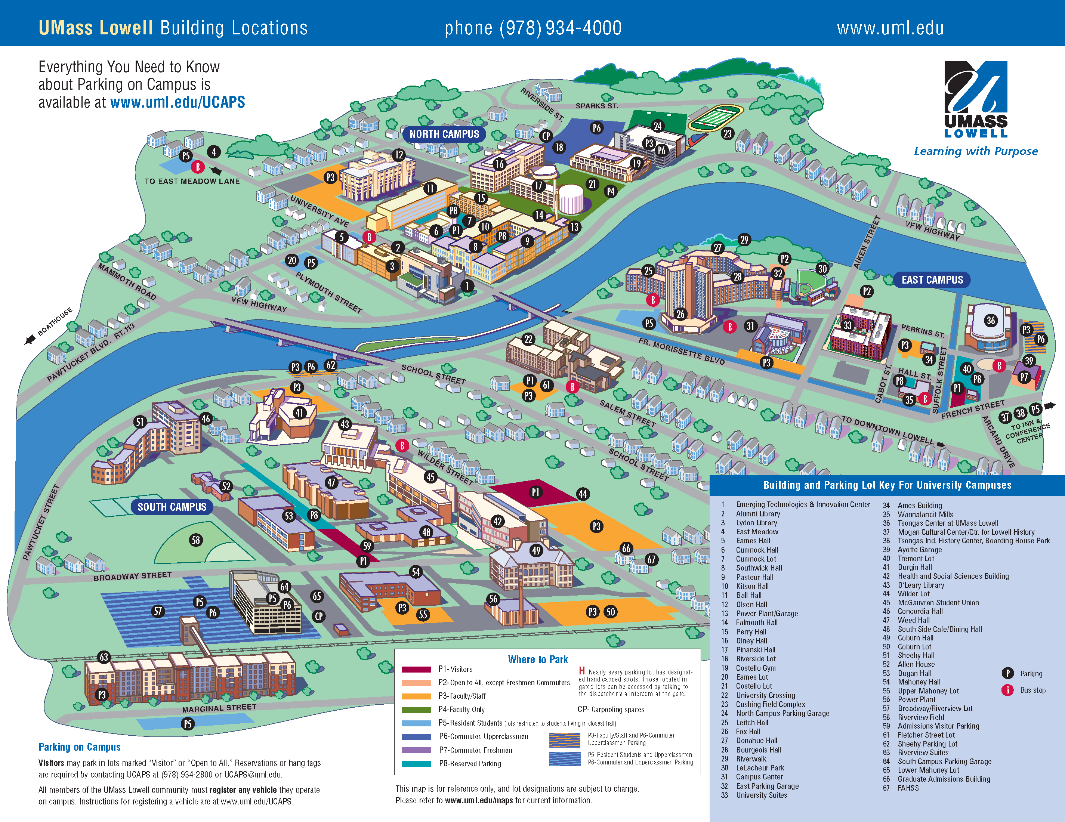
Spanning the Merrimack

Slide 4
UMass Lowell in 2015
Enrollment: 17,191 (+48 % since 2007 )
USNWR: 156
Second-fastest rising university over last four years
100 Undergraduate majors, 42 Masters programs, 36 Doctoral degrees
10 new buildings opened since 2009
Overall student diversity up 38%
% Pell eligible: 33%

Slide 5
Building Student Success
One-year Retention: Up 9% since 2006
Two-year Retention: Up 9% since 2005
Six-year Graduation: Up 10% since 2003

Slide 6
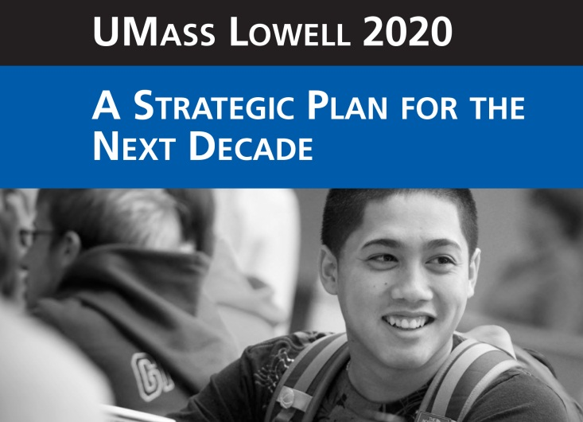
Developing the Strategic Plan
Over 200 participants: faculty, staff, students
11 committees focused on core mission, strategic priorities, infrastructure and management, advancement
Committees recommended strategies with metrics and goals

Slide 7
Identifying Guiding Principles
Strategic priorities articulated by five “Pillars of Excellence”:
Transformational Education
Global Engagement and Inclusive Culture
Innovative Research and Entrepreneurship
Leverage Our Legacy and Our Place
Entrepreneurial Stewardship
Highly visible on campus

Slide 8
Transparency and Accountability
UMass Lowell Report Card
Framework established by UMass Lowell 2020
Reports on 25 strategic indicators
Sets five-year goals
Widely distributed and available
Encourages culture of transparency and accountability

Slide 9
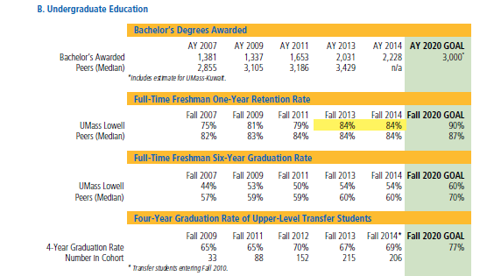
Traditional Metrics: Retention and Graduation Rates

Slide 10
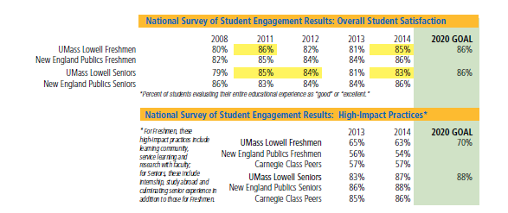
Acting on NSSE findings

Slide 11
Measuring Innovative Pedagogy

Slide 12
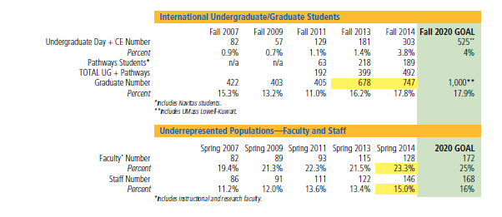
Inclusive Culture

Slide 13
Signature Strategic Initiatives
Using Data to Inform Campus Action
Expanding experiential learning
Creating Research and Community Coops
Building a 21st century core curriculum
Embedding ELOs in the disciplines
Moving departments toward data-driven decisions
Expanding global outreach
Developing pathway programs

Slide 14
Applying Data Strategically
Example: Gateway Courses
Using early warning data: Starfish
Using data analytics: Student Success Collaborative
Engaging professional advisors; Networking advisors
Curricular changes:
Supplemental education
Boot-camps
Discipline-specific math sections
Resource allocation: small sections

