Slide 1
Assessing Educational Effectiveness at
Central Connecticut State University
NEASC Annual Meeting
Dec 7, 2016
Glynis Fitzgerald – Associate Vice President, Academic Affairs
Dean, School of Graduate Studies
Yvonne Kochera Kirby – Director of Institutional Research and Assessment
Carl R Lovitt – Provost & Vice President Academic Affairs

Slide 2

CCSU Profile
  Comprehensive public 4-year master’s level institution
  Approximately 12,000 students
  130+ Academic programs (undergraduate and graduate level)
  Faculty – approx. 450 FT, 500 PT
  39 Academic departments
  5 Academic schools/colleges

Slide 3
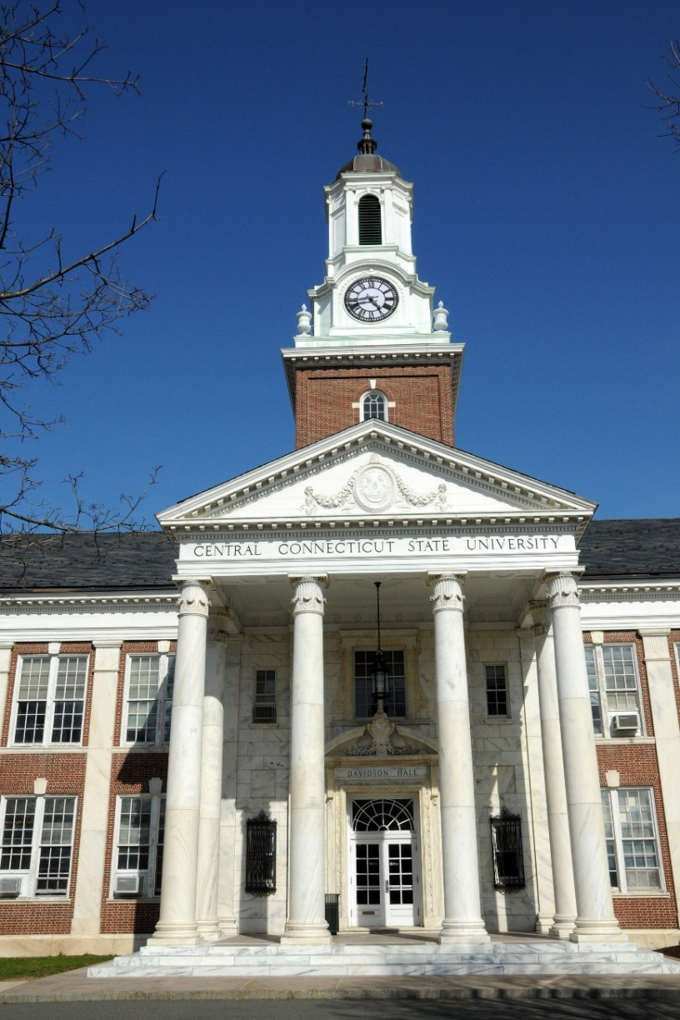
Culture: Data-Based Decision Making
Elements for a data-driven campus….
Quality metrics
  Information must be useful
Data integrity
  Accurate
  Defensible & consistent definitions
  Sustainable
  Updated regularly
  Effective communication

Slide 4
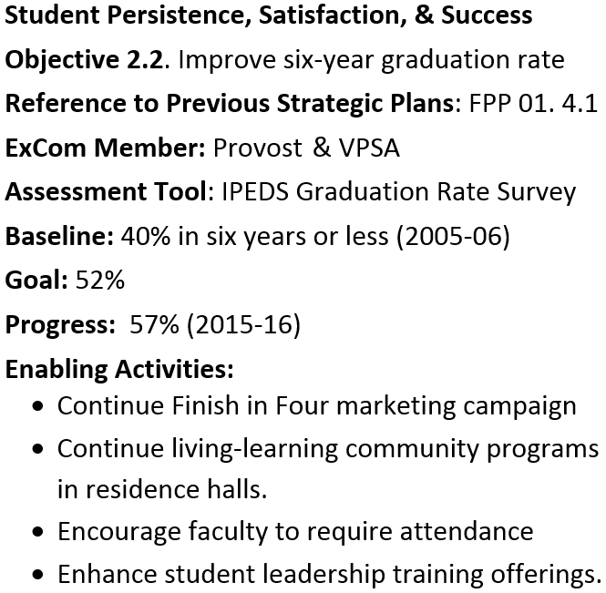
Data-based Strategic Plan
Strategic Plan
  All Divisions engaged
  8 Goals, ~ 50 Objectives
  Each Objective
    6 key components
  Updated annually
  Communicated to campus
    Opening remarks
    Website
  Periodic “Report Card”

Slide 5

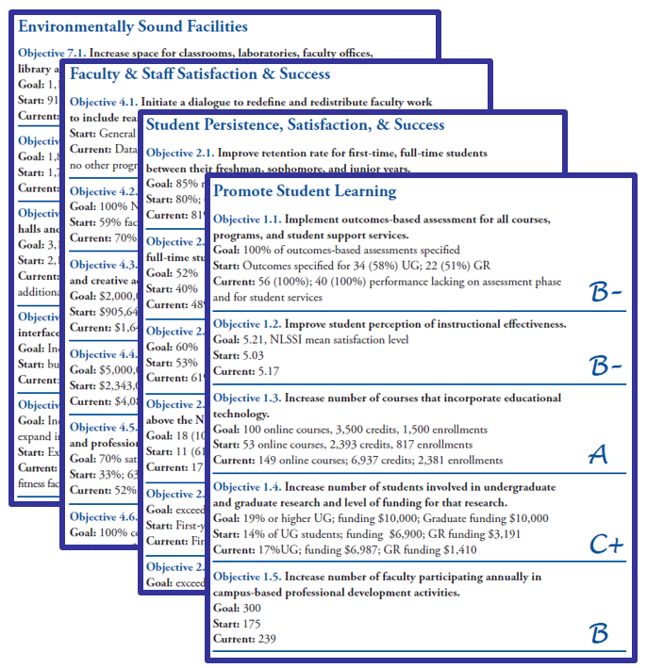
Data-based Strategic Plan:
Periodic Report Card

Slide 6
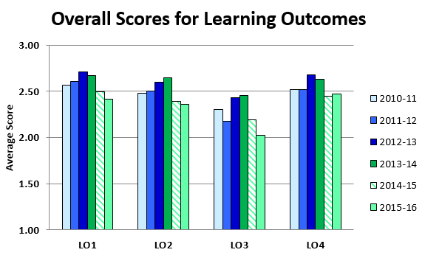
Infrastructure for Program Assessment:
Academic Program Assessment
Academic Assessment Committee
  Standing Committee of the Faculty
  16 Faculty members & Dir. Inst. Research & Assessment
  5-year reporting cycle – full report (evaluated) followed by 4 interim reports
  Rubric
    Learning Outcomes
    Data/Findings
    Analysis
    Use of Results
  Feedback provided

Slide 7
Infrastructure for Program Assessment:
Academic Program Assessment
External Program Review
  Faculty Senate approved policy
  Review schedule: 5-year cycle
  4 overarching themes in self-study:
    Program Learning Outcomes
    Academic Program Profile
    Faculty
    Future Plans
  External reviewer comments on
    Strengths and weaknesses
    Proposed changes
    Use of data to inform decision making

Slide 8
Infrastructure for Program Assessment:
General Education
General Education – wants and needs
  University-wide results
  Common criteria
  Assessment just prior to graduation
Multi-State Collaborative - SHEEO & AAC&U initiative
  Simple Concept:
    Use existing assignments from courses
    Collect artifacts from seniors
    Confirm alignment with one of 3 VALUE rubrics
      Critical Thinking
      Written Communication
      Quantitative Literacy (Reasoning)

Slide 9

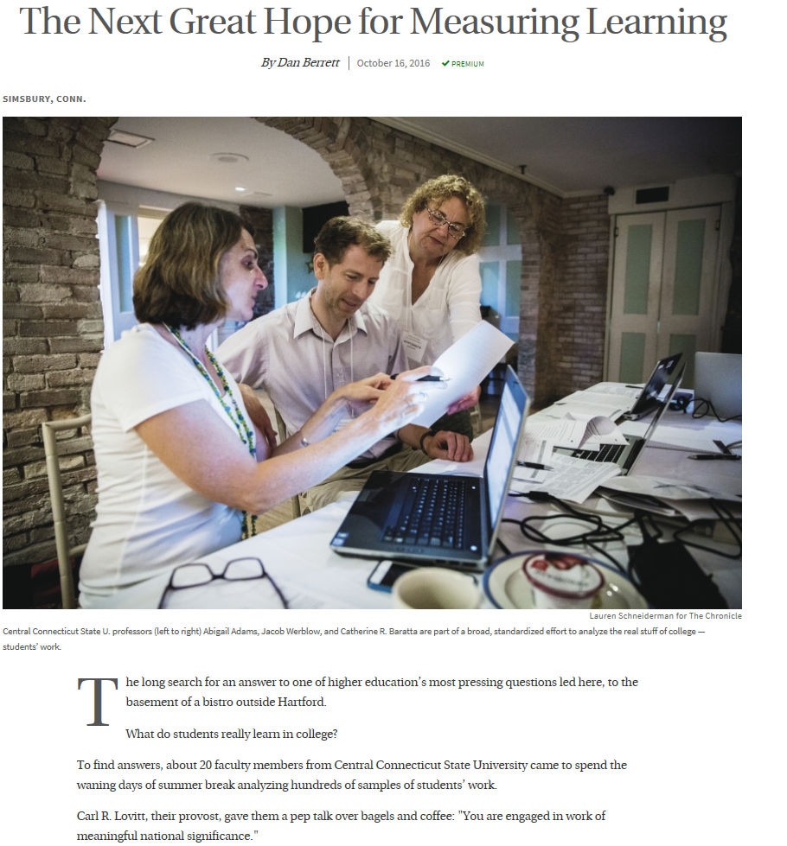
Infrastructure for Program Assessment:
General Education
Strategy
  Participate in the MSC
    Non-CCSU faculty assess
  Adopt “MSC model” for GE
    Collect all artifacts from course
    Assessment retreats for CCSU faculty to score
Results
  CCSU scores similar to other 4-year institutions (MSC data)
  MSC and CCSU scores similar
    same artifact scored

Slide 10
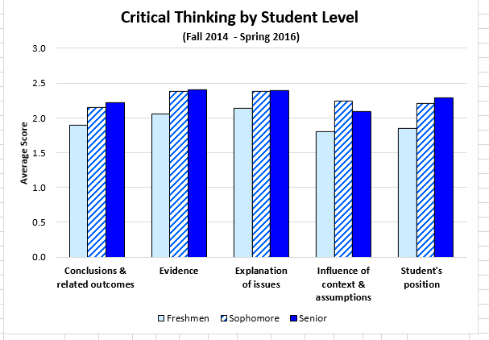
Infrastructure for Program Assessment:
General Education
MSC model – activities to date
  3 Assessment retreats
  Scored > 850 artifacts
  Good distribution across academic majors
  Informative data
  Faculty participation from 50% of departments
  Provide results to contributing faculty
Learning Outcome | Students Assessed (N) | % of Undergrad. Majors
CT | 261 | 55%
QR | 376 | 58%
WC | 219 | 62%

Slide 11
Examples of Educational Effectiveness
Pre-Collegiate and Access Services
Students from first to second year were retained slightly higher but graduate at a lower rate
Benefit of High Impact Practices, specifically course abroad experiences
International Education is one of our elements of distinctiveness
  ALL students who participated in first two Passport to Global Citizenship Programs have or will graduate before May 17

Slide 12
Examples of Educational Effectiveness
The Learning Center
% of probationary students who completed a TLC intervention and increased their cumulative GPA End of probationary Semester –
 | FALL 2013 | SPRING 2014 | FALL 2014 | SPRING 2015 | FALL 2015 | SPRING 2016
OVERALL – ALL INTERVENTIONS | 77%↑ N= 165 | 77%↑ N= 234 | Data not available | 72%↑ N = 280 | 88%↑ N = 187 | 85%↑ N = 239
Academic Coaching (TLC 001) | 78%↑ N= 123 | 80%↑ N= 169 |  | 72%↑ N = 164 | 87%↑ N = 150 | 87%↑ N = 149
Making the Dean’s List (TLC 004) | 76%↑ N= 25 | 83%↑ N= 41 |  | 70%↑ N = 53 | 90%↑ N = 21 | 84%↑ N = 57
Individual TLC Workshop (TLC 005) | 71%↑ N= 17 | 46%↑ N= 24 |  | 64%↑ N = 14 | 86%↑ N = 16 | 73%↑ N = 30
Character Strengths for Success (TCL 007) |  |  |  | 82%↑ N = 28 |  | 93%↑ N = 15
This chart demonstrates the relationship between successful completion of a TLC Academic Intervention and Improved Academic Performance as measured through GPA for First-Time Probationary students.
Notes:
The university has made a substantial investment in helping students who are not performing successfully in college and those who need additional support and guidance to succeed. The Learning Center provides support services that include individual and small group academic success coaching, early alert counseling and referral, tutoring in specific academic subjects and academic inteventions for students on academic probation. The impact of these services on student success has been assessed through such measures as student surveys, transcript analsysi and analysis of related items from National Survey of Student Engagement (NSSE)
Slide is a summary of the impact of specific interventions on students’ academic performance. We share this information with students, so that they may make an informed intervention choice.
We have also measured the impact of participation in the required pre-term academic probation advising and success session in order to determine if it is a worthwhile endeavor. (It is!)
Another assessment determined that students who complete 3 sessions prior to midterm are more successful than students who complete all 6 sessions between midterm and finals. We used this information to inform our policies and to motivate students to start work with a coach earlier in the semester.
We also measure student satisfaction with our tutoring services through survey results. This information allows us to best meet the needs of our students. Survey results are used to improve or expand tutor training, judge marketing effectiveness, and maintain the quality of service delivery in general.

Slide 13
Examples of Educational Effectiveness
Program Review of Biomolecular Sciences
Tied to Mission statement - Central Connecticut State University is a community of learners dedicated to teaching and scholarship that emphasizes development and application of knowledge and ideas through research
Excerpt from Analysis section of the report:
  Students tended to perform better on technical tasks
  Although the students can perform the technical tasks, their overall understanding of the techniques and how they relate to the research question may be falling short.
Excerpt from Responses to findings section of the report
  Require all students participating in an independent research project, regardless of class rank, to generate a formal figure, complete with a detailed legend that addresses the background, methodology, data analysis and interpretation of results
  Requiring the students to generate these formal figures will provide them additional practice that should ultimately enhance their creation of a formal poster/platform presentation

Slide 14
Areas for Improvement
  Closing the Loop with Program Review
  Tracking Alumni Success
  Measuring Impact of Community Engagement
  Unpacking Benefits of International Education
  Assessing Outcomes of Professional Development

Slide 15
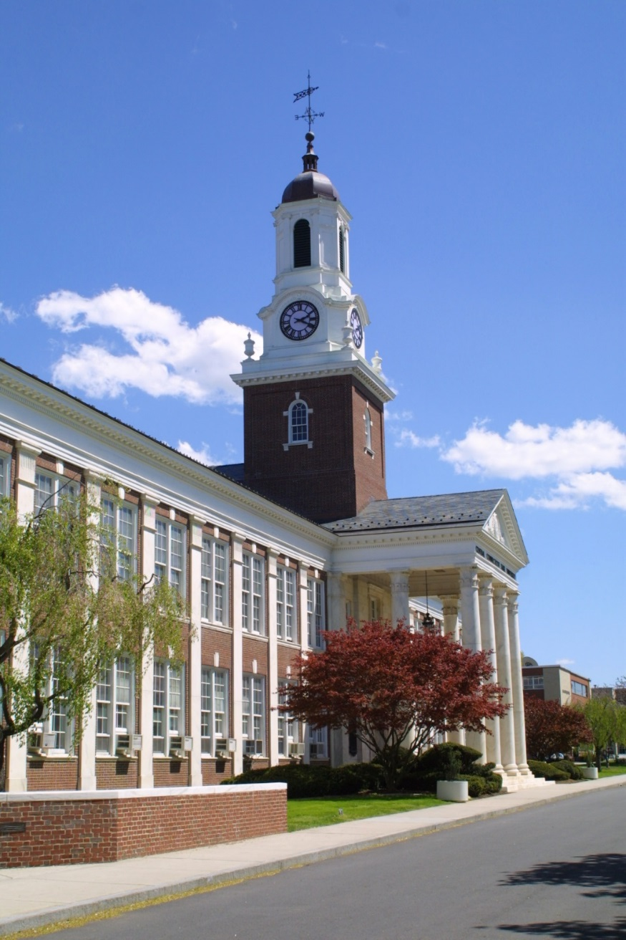
Questions???
Glynis Fitzgerald –
  FitzgeraldG@ccsu.edu
Yvonne Kochera Kirby –
  ykiby@ccsu.edu
Carl R Lovitt –
  lovittcar@ccsu.edu

Slide 16
Collaborative Activity
At your tables, briefly discuss your experiences with assessing outcomes that are not directly associated with classroom-based learning (e.g., peer mentoring, community-based project, undergraduate research, international education, etc.)
  What outcomes did you measure?
  How did you measure them?
  What changes did your findings lead you to make?
Ask someone to record the examples discussed
Ask someone at each table to share one
example with the larger group

