Slide 1
Vice-President’s Planning Session January 14, 2014 Philip J. Sisson Provost/VP of Academic and Student Affairs Middlesex Community College sissonp@middlesex.mass.edu
Online Student Retention:
Data Driven Challenges and Strategies
Academic & Student Affairs Issues and Challenges
130th NEASC Annual Meeting and Conference
December 11, 2015
Philip J. Sisson
Provost/VP of Academic and Student Affairs
Middlesex Community College
sissonp@middlesex.mass.edu

Slide 2
MCC Fast Facts
About Middlesex Community College
Mission: At Middlesex Community College, everyone teaches, everyone learns. Collaborative in nature and innovative in practice, we educate, engage, and empower a diverse community of learners. Through transformative opportunities, we challenge and support every student to succeed and lead. Recognizing equity and inclusion as the foundation for excellence and creativity. Middlesex Community College meets the evolving educational, civic and workforce needs of our local and global communities.
President: Dr. James C. Mabry
Established:
1970 - Bedford campus opened
1987 - Lowell campus opened
Type of School: Public, Community College
Degrees awarded: Associate Degrees, Credit and Noncredit Certificates

Slide 3
MCC Fast Facts (cont’d)
Middlesex Academics
Majors: More than 75 degree and certificate programs
Full-time Faculty: 125
Part-time Faculty: 460
Average Class Size: 21
International Study: International Education Fellowships are academic opportunities for MCC students to visit a country and study its history and culture. Since 1992, Middlesex has offered fellowships to China, Russia, Costa Rica, Spain, Ireland, Europe, Belize and Peru. Fellowships vary each year, and the choice of country depends on funding, travel restrictions and availability.
MCC Students
Total enrollment: 13,267
Full-time: (12 credits per semester): 5,307 (44%)
Female: 7,651 (58%)
Male: 5,616 (42%)
2013 Graduates: 1,325

Slide 4
Massachusetts Context

Slide 5
MCC Enrollment Context

Slide 6
MCC Enrollment Context

Slide 7
Online Learning

Slide 8
Course Completion Rates
 | AY 10-11 | AY11-12 | AY 12-13 | AY 13-14 | AY 14-15
Online Course Completion Rates | 70% | 73% | 72% | 73% | 72%
Face-to-Face Course Completion Rates | 76% | 76% | 77% | 78% | 78%

Slide 9
Online/Web
% Web Courses (Web includes Web, Hybrid, and Web with on campus lab) | 2015 Graduates
 | N | % | Total
100% of all MCC courses taken | 8 | 0.5% | 1462
At least 80% of all MCC courses taken | 24 | 1.6% | 1462
At least 50% of all MCC courses taken | 113 | 7.7% | 1462
At least 25% of all MCC courses taken | 364 | 24.9% | 1462
At least one online course | 1096 | 75.0% | 1462
No web/hybrid/web with on campus lab | 366 | 25.0% | 1462

Slide 10
Fall 2014 Student Enrollment | N | %
No Web courses | 6778 | 73.6%
All Web courses | 796 | 8.6%
Mix of web and not web | 1631 | 17.7%
Total | 9205 | 100%

Slide 11
 | Of the 2427 students who took a web class in Fall 2014: |  | Of the 9205 students enrolled Fall 2014:
 | N | % | N | %
Enrolled Spring 2015 | 1562 | 64.4% | 6186 | 67.2%
Enrolled in Web class in Spring 2015 | 1009 | 64.6% | 1877 | 30.3%
Enrolled in Fall 2015 | 982 | 40.5% | 4226 | 45.9%
Enrolled in Web class in Fall 2015 | 593 | 60.4% | 1408 | 33.3%

Slide 12
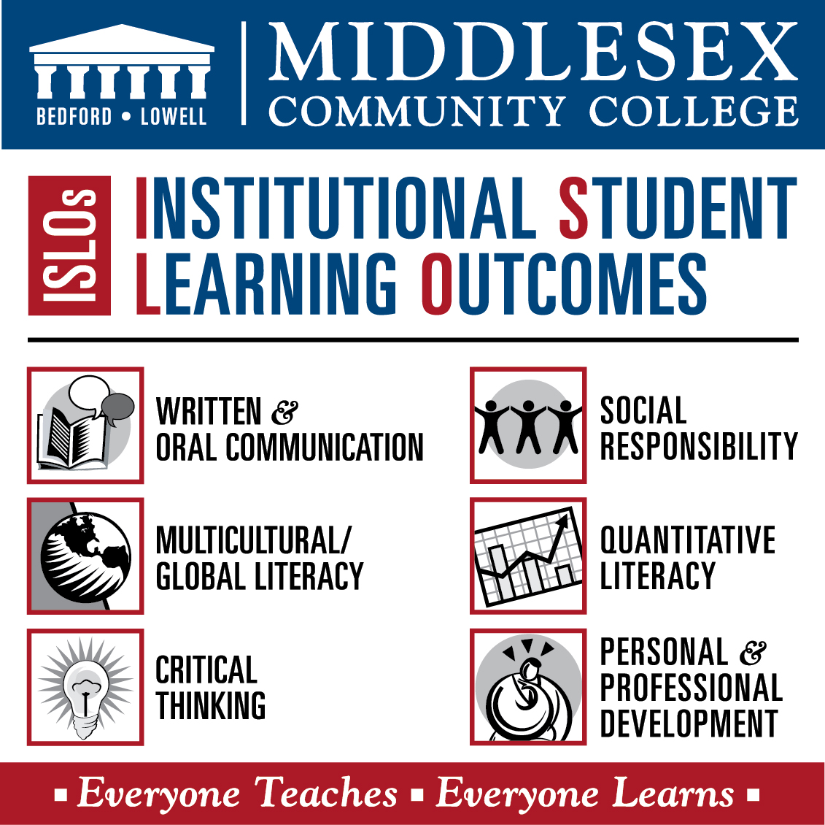

Slide 13
Pedagogical Training – Key to Success
The Eight General Standards:
Course Overview and Introduction
Learning Objectives (Competencies)
Assessment and Measurement
Instructional Materials
Learner Interaction and Engagement*
Course Technology
Learner Support
Accessibility and Usability

Slide 14
*EAB - Charting a Path to Persistence

Slide 15
Promoting persistence among adult and online learners requires:
Monitoring indicators of students’ financial, academic, and engagement risk and embedding intervention and follow-up into instructor and advisor workflow
Encouraging re-enrollment by tracking term-to-term persistence and securing advance permission to contact students following necessary stop-out periods
Facilitating adult degree completion by eliminating both real and perceived barriers to enrollment through proactive outreach campaigns, simplified readmission procedures, and special financial incentives
*EAB - Charting a Path to Persistence

Slide 16
Monitor Stop-Out Risk
1 Financial Risk 1. Financial Hold Reconciliation 2. Triaged Administrative Support 3. Self-Service Financial Aid Counseling | 2 Academic Risk 4. Discussion Post Risk Tags 5. Faculty Tutorial Referrals 6. Risk Score Analytics | 3 Engagement Risk 7. Midterm Stress Questionnaire 8. Practical Community Engagement
Encourage Re-enrollment 4 9. Escalating Re-enrollment Outreach 10. Proactive Re-approach Campaign | Facilitate Adult Degree Completion 5 11. Expedited Re-admit Procedures 12. Second Opportunity Financial Incentives 13. Statewide Completion One-Stop Shop *EAB - Charting a Path to Persistence

Slide 17
Save the Date: Call for Proposals Share Your Best Practices Deadline for Proposals: April 1, 2016
The Conference Committee encourages the submission of proposals that support the following topics: Teaching and eLearning
Delivering course content in an online and blended modality
Innovative ways of engaging students online
Maximizing student success
Promoting positive student interaction
Online class management
Copyright issues
Accessibility and learning accommodations
Technology
Innovative applications of technology
Learning Management Systems:
Tips and Tricks
Integrating Student Information Systems
Academic and Administrative Support
Library resources for online learners
Academic advising issues in eLearning
Tutoring online students
Best practices in managing eLearning programs
Evaluating blended courses instructional effectiveness
Please utilize the following guidelines when creating a conference presentation proposal.
You will be asked to provide: Title of Program (10 word maximum), Primary Presenter/ Contact, Summary (50 word summary for program flyer), Description (250 word maximum), Presentation Format, Presentation, Panel discussion, Hands-on workshop, Technology Requirements, Special Accommodations Required Online proposal form coming soon. Campus Contact Information: Customize

Slide 18
Recommended Reading
Bailey, S., Hendricks, S., Applewhite, S. - Student Perspectives of Assessment Strategies in Online Courses. Journal of Interactive Online Learning, Spring 2015, Volume 13, No. 3.
Banna, J., Lin, M., Stewart, M., Fialkowski, M. –Interaction matters: Strategies to promote engaged learning in an online introductory nutrition course. MERLOT Journal of Online Learning and Teaching, June 2015, Volume 11, No. 2.
Hachey, A., Conway, K., Wladis, C. - Community Colleges and Underappreciated Assets: Using Institutional Data to Promote Success in Online Learning. Online Journal of Distance Learning Administration, Spring 2013, Volume 16, Issue 1.
Jaggars, S. – Democratization of Education for Whom? Online Learning and Educational Equity. AAC&U, Diversity & Democracy 2014.
Educational Advisory Board – COE Forum: Charting a Path to Persistence, 2015

