Slide 1
Rankings and the Emergence of New Forms of Accountability
Professor Ellen Hazelkorn
Policy Advisor to the Higher Education Authority (Ireland)
Director, Higher Education Policy Research Unit (HEPRU)
130th NEASC Annual Conference and Meeting
December 2015
Boston

Slide 2
Which are the Best Universities & Colleges?
Are the best universities those which best match the criteria established by the different rankings OR those that help the majority of students earn the credentials for sustainability living and employment?
Are the best universities those that contribute to new scientific discoveries and highly trained PhDs OR those that “emphasize the obligations students have to serve their communities and the nation at large”?
  Are the best universities those that reinforce an elite knowledge society (where progress depends on the cutting-edge knowledge of the few) OR those that help build-up a mass knowledge society (where progress depends on the “wisdom of the many”)?
  Should we define quality according to reputation/prestige, student satisfaction, salary level of graduates OR how students have been transformed by their educational experience, e.g. learning gain?

Slide 3
Themes
Rankings and their Legacy
New Forms of Accountability
Implications for Higher Education

Slide 4
1. Rankings and their Legacy

Slide 5
Rankings’ Legacy
Global rankings have become a game-changer;
Immediately – and subsequently – attracted attention of policymakers and the academy:
  Choice of indicators has set parameters for what constitutes quality;
  Visible measure of global competitiveness and multi-polar character;
  “Top 100” has transformed “world-class” into a strategy, a language, a topic of study;
  Driven profound transformation of our HEIs and HE systems;
  Placed HE/R&D investment high on political and policy agenda.
Today, less about student choice and more about geopolitical positioning.
And in the process, a whole industry has been created.

Slide 6
World Order According to Rankings
Top 100, 2004-2015
Notes:
Key: THE-QS = Times Higher QS World Ranking 2003-2009; ARWU = Academic Ranking of World Universities 2003-; QS World University Ranking 2010-; TH-TR = Times Higher Thompson Reuters World Ranking 2010 -; Webometrics 2004-; SCImago 2009-.
Note: THE-QS is combined with QS for 2011 as the methodology is broadly similar; THE-TR is omitted as it was only established in 2010.

Slide 7
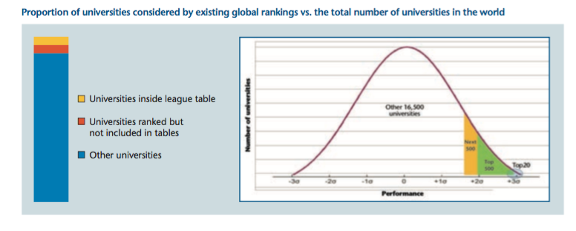
Measuring an Elite
Over 18,000 HEIs world-wide, but global rankings focus on characteristics and performance of the top 100 universities;
  less than 0.5 percent of total;
  ~0.4 percent of total world population of 196m tertiary students (UIS, 2012).
As demand for HE grows worldwide, selectivity is accelerating.
Notes:
The top 100 universities represent less than 0.5 percent of the current total of almost 18,000 HEIs; this represents approximately 0.4 percent of the total world population of 196 million tertiary students (UIS, 2012).
Evidence shows that as demand for higher education grows worldwide, selectivity is accelerating.
This is because while overall student numbers are increasing, student numbers amongst top 100 is relatively stable – thus leading to a decreasing overall % of total students.

Slide 8
Influence of Rankings
Restructuring of national systems;
Reshaping of national priorities;
Refocusing of institutional priorities;
Reorganising the HEI, institutional departments and hierarchy of disciplines;
Emphasis on research vs. teaching; postgraduate vs. undergraduate – with implications for the academic profession;
Changes in research practice: language, publication, orientation, basic/applied, etc.
Influence on stakeholders – students, governments, business/employers, investors, public, etc.

Slide 9
Measuring Quality
Despite all the criticism, rankings have succeeded in placing HE within a wider comparative and international framework;
    Quality and excellence are key differentiators in national/global market;
  National geo-political positioning and pride;
  Beacon to attract/retain investment, business and talent;
  Institutional reputation and status;
  Performance assessment of scientific-scholarly research;
  Link between qualification and career opportunities and life-style;
  Value-for-money and return-on-(public) investment;
“All the things wrong with the rankings matter considerably less than the plain fact that the rankings matter” (Locke, 2011, 226)

Slide 10
Global Significance
Global economy critical to understanding significance and impact:
Early years associated with tail-end of long period of economic growth driven by unregulated finance capital;
Latter years marked by lingering effects of global economic crisis – and search for sustained recovery and economic growth:
  Intensification of competition for a greater share of mobile capital and talent;
  Noticeable shifts in “world order”;
  Significant demographic changes;
  R&D investment patterns and geographic imbalances;
  HE is big business for nations and institutions;
    Internationalisation
    Deregulation of HE market: for-private/cross-border providers.
Notes:
Quality and status of HEIs and university-based research are vital indicators of competitiveness.
‘the size and strength of higher education systems are determined by possession of world class universities which are considered [a] more powerful asset for a nation than possession of weapon[s] of mass destruction’ (Billal (n.d. 2)
Russian Minister for Education said rankings were an ‘instrument of competitive battle and influence’ (Kishkovsky, 2012)
(UN, 2011a, p2).
This was an inevitable progression once education was recognized as a globally traded service under GATS (General Agreement on Trade in Services).

Slide 11
Quality now a Geopolitical Issue
As globalisation accelerates and market principles intrude further, growing need, arguably out of necessity, to regulate the marketplace;
  Supra-national governments, national governments/US states, HE agencies, commercial media, HE organisations;
  Global intelligence business leading to common international data set;
  In global labour market, quality credentials are essential for international recognition.
Greater government involvement either directly in the process and/or use of outcomes in policy and decision making;
    Signals extent to which HE is losing role as primary guardian of quality (Harman, 2011, 51; Dill and Beerkens, 2010, 313-315).
  Explains why global rankings have assumed such significance at a geopolitical level.
Notes:
No such thing as an objective ranking – because:
Choice of indicators and weightings reflect value-judgements or priorities of rankers;
Measurements are rarely direct but consist of proxies;
The evidence is never self-evident.
Rankings do not measure what people think they measure:
Each system measures different things – and are not directly comparable;
Measure what is easy and predictable;
Concentrate on past performance rather than potential;
Emphasis on quantification as proxy for quality;
Compare complex HEIs across different context and mission.

Slide 12
2. New Forms of Accountability

Slide 13
Alternative Rankings/Alternatives to Rankings
Rankings have been the dominant instrument but there are a range of other tools being developed:
  Alternative rankings by competitors, as new products and services;
  Alternatives to rankings by governments, agencies, HE, and others.
Traditionally, quality was measured in input (e.g. student entry, academic qualifications, budget/income, library resources) and reputation;
As the “private” and “public” good roles of higher education come under increasing scrutiny, the focus has shifted to outputs, outcomes, impact, benefit and relevance;
Shows different ways to measure quality.

Slide 14
Transparency & Accountability Instruments
Rankings
Classification & Profiling
Qualifications Frameworks
QA & Learning Outcomes
Scorecards & Websites
Global intelligence
Social Networking

Slide 15
Rankings
Rankings
Classification & Profiling
Qualifications Frameworks
QA & Learning Outcomes
Scorecards & Websites
Global intelligence
Social Networking

Slide 16
Global Rankings
Academic Ranking of World Universities (ARWU) (Shanghai Jiao Tong University, China), 2003
Webometrics (Spanish National Research Council, Spain), 2004
National Taiwan University Rankings (formerly Performance Ranking of Scientific Papers for Research Universities, HEEACT), 2007
Leiden Ranking (Centre for Science & Technology Studies, University of Leiden), 2008
SCImago Journal and Country Rank (SJR) (Spain), 2009
University Ranking by Academic Performance (URAP) (Informatics Institute of Middle East Technical University, Turkey), 2009
QS World University Rankings (Quacquarelli Symonds, UK), 2010
THE World University Ranking (Times Higher Education, UK), 2010
U-Multirank (European Commission, Brussels), 2014
Best Global Universities rankings (USNWR, US), 2014

Slide 17
Select National Rankings (red = government sponsored)
INSTITUTIONAL | DISCIPLINE/ SUB-CATEGORIES | SPECIALIST
University Ranking System (Bulgaria) CHE-HochschulRanking (Germany) Expert University Ranking (Russia) Good University Guide (Australia) Guardian University Guide (UK) University Rankings of Islamic Countries (Iran) Higher Education Commission Rankings (Pakistan) La Repubblica Grande Guida Università (Italy) Maclean’s On Campus (Canada) National Rankings of Best Universities (Kazakhstan) Netbig Chinese University Ranking (China) Nigeria Universities Commission Ranking OHEC (Thailand) Perspektywy University Ranking (Poland) Ranking U-Sapiens (Colombia) Sunday Times Good University Guide (Ireland) Times Higher Education University Guide (UK) Top 200 University Rankings (Ukraine) URANK-rank (Sweden) US News and World Report (USNWR) College Rankings (US) | Dataquest (India) India Today (India) Outlook (India) Le Nouvel Observateur (France) Sherif Magazine (Iran) National Research Council Ranking of Doctoral Programmes (US) Toplawschools.com (US) American Universities Admission Programme: Undergraduate American Universities Rankings for International Students (US) US News and World Report (USNWR) Top Med Schools (US) WPROST MBA (Poland) | CollegeNET Social Mobility Index Ranking (US) Georgetown Public Policy Review Placement Efficiency Ranking (US) Metroversities (US) New York Times Most Economically Diverse Top Colleges (US) Online Study Australia Online University Ranking List (Australia) Princeton Review (US) Saviours of Our Cities (US) Social Mobility Index (CollegeNet and Payscale, US) Washington Monthly College Guide (US) Washington Monthly Ranking of Community Colleges (US)
Notes:
Growing range and number of national and regional rankings – either promoted by governments or ranking organisations
Serve to drive up performance and also to signal quality to international business and competitors
Asia, South America, Maghreb, BRICS, India, UAE,
EU - U-Multirank

Slide 18
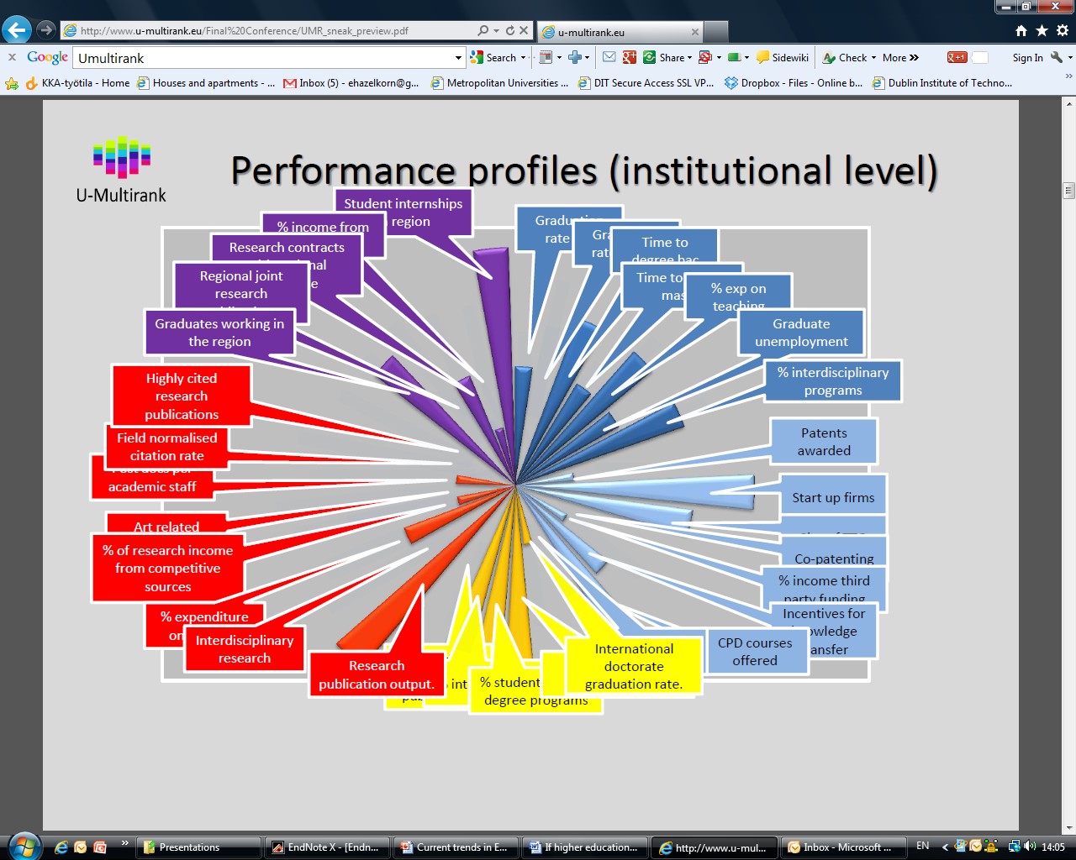
U-Multirank

Slide 19
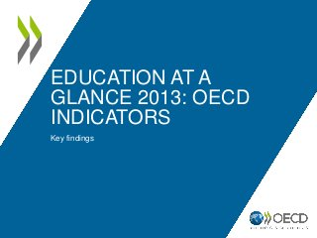

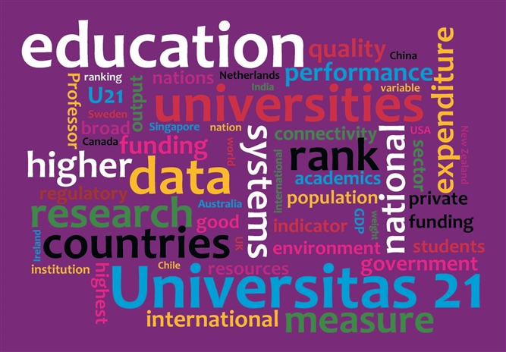
Notes:
System-level Rankings: Universitas 21, Lisbon Council.
Assess quality, impact and benefit of HE system as-a-whole using broad set of indicators: e.g. investment, access and participation rates, contribution of higher education and research to society, internationalisation, government policy and regulation;

Slide 20
Classification & Profiling
Rankings
Classification & Profiling
Qualifications Frameworks
QA & Learning Outcomes
Scorecards & Websites
Global intelligence
Social Networking
Notes:
The Carnegie Classification of Institutions of Higher Education Starting in 1970, the Carnegie Commission on Higher Education developed a classification of colleges and universities to support its program of research and policy analysis.
The 2010 Classification update retains the same structure of six parallel classifications, initially adopted in 2005. They are as follows: Basic Classification (the traditional Carnegie Classification Framework), Undergraduate and Graduate Instructional Program classifications, Enrollment Profile and Undergraduate Profile classifications, and Size & Setting classification. These classifications provide different lenses through which to view U.S. colleges and universities, offering researchers greater analytic flexibility.
Classifications are time-specific snapshots of institutional attributes and behavior based on data from 2008 to 2010. Institutions might be classified differently using a different time frame.

Slide 21
U-Map
Profiling tool to facilitate easy comparison between different institutions and inform student choice or strategic decision making by institutions or governments.
Similar initiatives have been developed by Norway, Ireland, Australia
Notes:
CLASSIFICATION: provide a typology or framework of higher education institutions to denote diversity according to mission and type, e.g. Carnegie Classification, U-Map:
Have had considerable influence on how different HEIs are described – with positive and perverse effects;
Classification has become rigid description of the system and HEI roles – translated into a hierarchy.
PROFILING: tool to highlight diversity of institutional missions and activities:
Having developing influence as an institutional and government tool;
Uses a wider range of indicators than classification systems;
Results often produced as a spider-web in order to show visually differences between institutions according to particular sets of indicators.

Slide 22
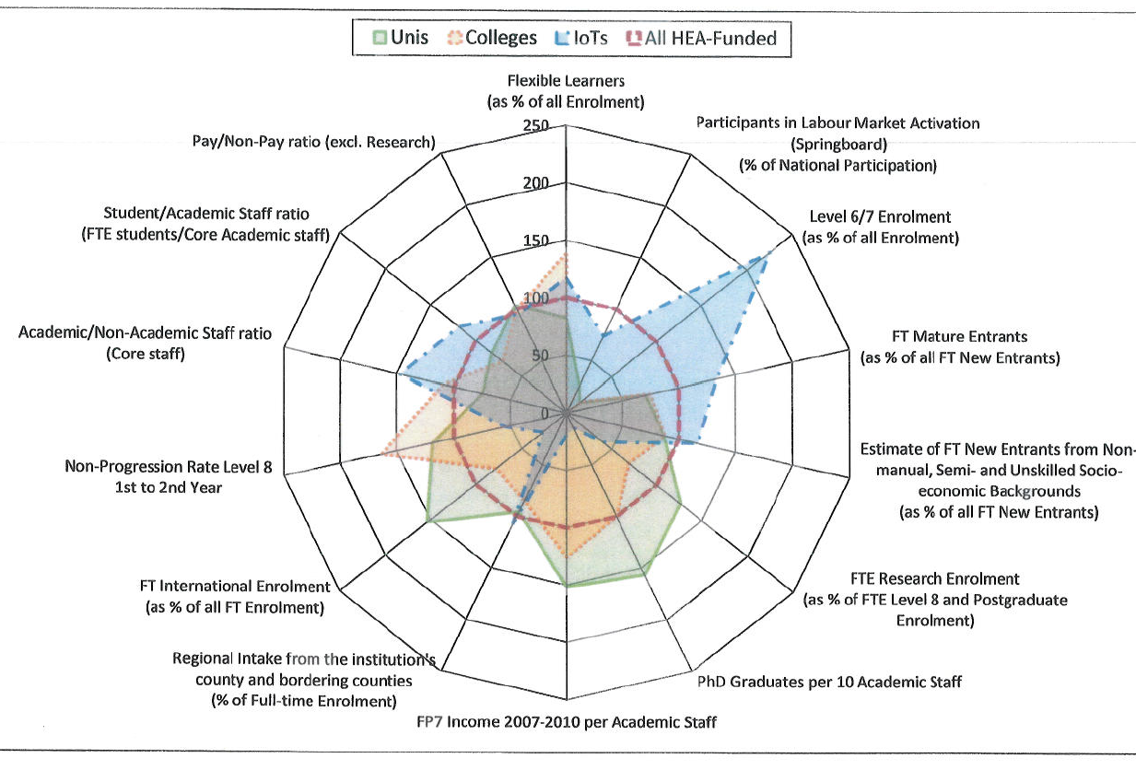
Notes:
Institutional profiling: U-Map, Ireland
Variation on classification; for Public and institutional benchmarking

Slide 23
Qualifications Frameworks
Rankings
Classification & Profiling
Qualifications Frameworks
QA & Learning Outcomes
Scorecards & Websites
Global intelligence
Social Networking

Slide 24
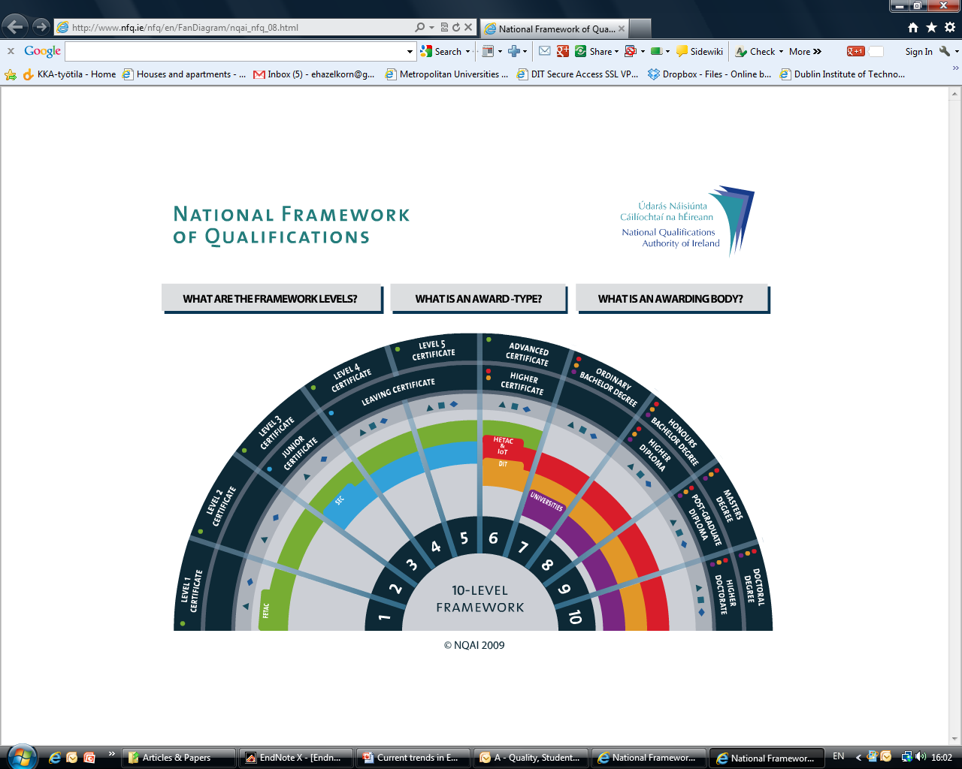

Slide 25
QA & Learning Outcomes
Rankings
Classification & Profiling
Qualifications Frameworks
QA & Learning Outcomes
Scorecards & Websites
Global intelligence
Social Networking

Slide 26


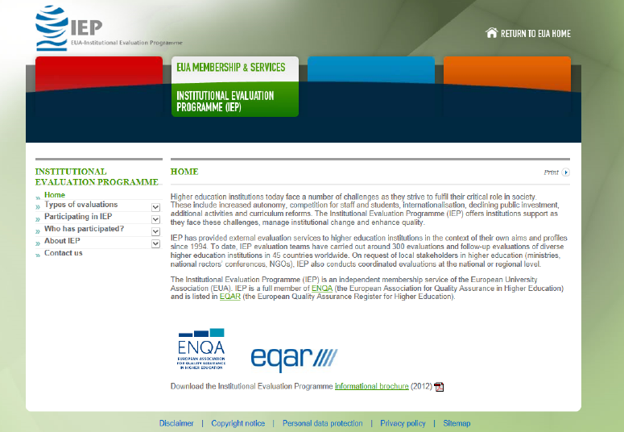


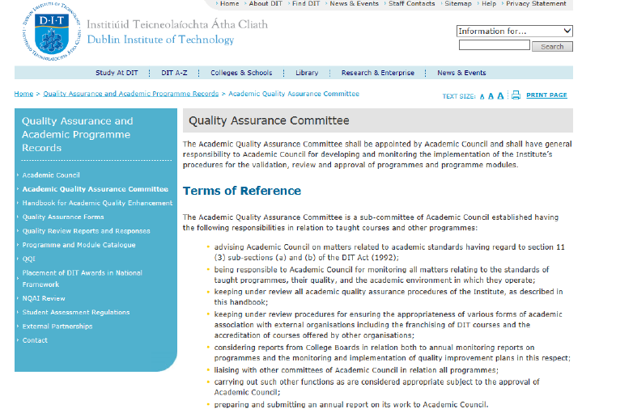
Notes:
Quality assurance has traditionally been via peer-review; similar to the accreditation process here, the emphasis has been on institutional guality enhancement – processes by which the uniersity/college oversees and monitors quality.
On a spectrum from light touch to top-down regulation, the FINHEC audit is strongly focuses on the institution and its processes. At the other end, TEQSA in Australia initially introduced a risk-based system replacing the previous university led process under AQUA.
EUA has pioneered the Institutional Evaluation Programme (IEP) which involves review/assessment with 4 key questions:
What are you trying to do?
How do you know you are achieving?
New initiatives by the UK and Australian governments return to this approach.
One of the key arguments against traditional academic peer review approach is its heavy (too heavy) emphasis on process.

Slide 27
Lessons from Bologna
Bologna places quality within broader educational framework;
Big idea is the “accountability loop”:
  Qualification framework facilitates flexible learning paths and sets out clear statement of what students must demonstrate at each qualification level
  “Tuning” aids (re-)design, development, implementation, evaluation and enhancement of quality degree programmes within context
  Formalized concept of learning outcomes rather than measuring inputs (e.g. credit hours, classroom teaching, entry grades)
  QA systems sets evaluation standards and guidelines for institutional self-assessment and quality processes, and external monitoring
  Diploma Supplement provides description of academic career and the competencies acquired
Notes:
Assessment of Learning Outcomes/Value-for-Money
Influence of Bologna has focused attention on outputs of learning, but increased attention on measuring results in response;
NESSE – now operating in Australia, Ireland, UK developing model
CLA – Collegiate Learning Assessment
OECD – AHELO
Lumina Foundation Degree Qualifications Profile

Slide 28
Measuring & Comparing
Achievements of Learning Outcomes
CALOHEE is a EU funded project drawing on the Tuning experience beginning 2017;
Seeks to study whether students enrolled in HE around Europe develop the appropriate competences by looking at study programmes, and whether they deliver their promises;
  Unlike AHELO which looks at institutional level, this project looks at the programme level
Will focus on 5 domain: Engineering (Civil Engineering), Health Care (Nursing), Humanities(History), Natural Sciences (Physics), and Social Sciences (Education).

Slide 29
AHELO
Assessment of Learning Outcomes developed by OECD in response to criticism of rankings;
Attention on outputs of learning,
  Generic skills common to all students (such as critical thinking, analytical reasoning, problem-solving, and written communication).
  Discipline-specific skills in economics and engineering
  Contextual questionnaires are also being given at the student, faculty and institution level to link the data to student backgrounds and learning environments.
Notes:
January 2010 to June 2011 - development of testing instruments for the generic and discipline-specific skills in economics and engineering and small-scale validation of these instruments.
Phase 2 - January 2011 to December 2012 - administration of the tests (and contextual questionnaires) in participating institutions.
December 2012: end of the feasibility study and publication of Volume 1 of the feasibility study report on feasibility by the OECD (Design and Implementation - already published: Full report, Executive Summary).
February 2013: Publication of the second volume of the feasiblity study report on Data Analysis and National Experiences (already published (Full report, Executive Summary).
Feasibility study conference on 11-12 March 2013 in Paris: Measuring learning outcomes in Higher Education: Lessons learnt from the AHELO Feasibility Study and next steps.
October 2013: Publication of the third and final volume of the report on further insight (and including the Conference proceedings).
Conclusion: based on the results of the feasibility study, OECD member countries will decide whether to delve deeper into the subject as well as set out steps towards conducting a full-scale AHELO.

Slide 30
Teaching Excellence Framework (UK)
TEF will replace QAA;
New Office of Student (OfS);
Spotlight on teaching, and encourage excellent teaching;
Provide extensive information to students and employers;
Metrics:
  Teaching quality
  Learning environment
  Student outcomes and learning gain
Institutions which perform against TEF can raise tuition fee;
  Institutions which do not - will fail.
Notes:
The Higher Education Green Paper, Fulfilling our Potential: Teaching Excellence, Social Mobility and Student Choice,

Slide 31
Scorecards & Websites
Rankings
Classification & Profiling
Qualifications Frameworks
QA & Learning Outcomes
Scorecards & Websites
Global intelligence
Social Networking
Notes:
College Scorecard replaced the Ratings and Paying for Performance (US)
Access, such as percentage of students receiving Pell grants
Affordability, such as net price and loan debt
Outcomes, such as graduation and transfer rates, earnings of graduates, and completion of advanced degrees.
Public Data available via government sites: Windaat, Catalonia; Unistats, UK; MyUni, Australia; ExeCum, Mexico

Slide 33
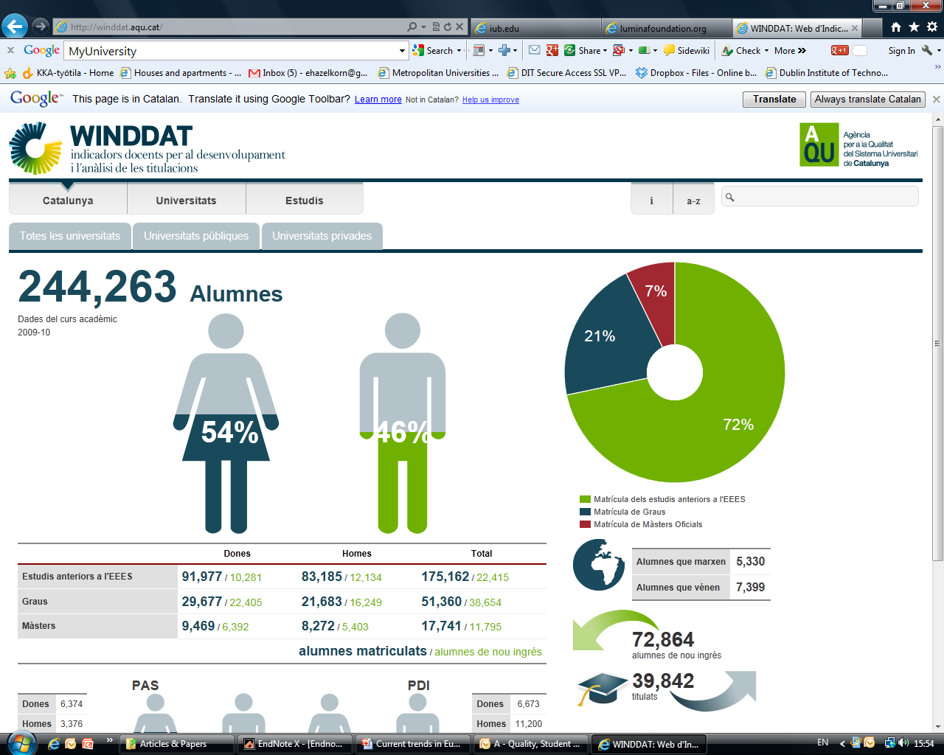

Slide 34


Slide 35
Quality Indicators for Learning and Teaching (Australia)
Purpose built website known as QILT (www.qilt.edu.au).
  Replaces My-Uni
Helps students and families make informed choices;
Data on:
  Overall satisfaction of current students
  Overall satisfaction of recent graduates
  Outcomes of students moving into full-time employment after graduation
  Median salary received by recent graduates.
Notes:
From 2015 onwards there will be changes to the surveys. They include:
The University Experience Survey is being renamed Student Experience Survey, measuring satisfaction of current students.
The Graduate Destination Survey will be replaced by the Graduate Outcomes Survey (GOS) examining labour market outcomes of higher education graduates.
There is progress being made setting up a new Employer Satisfaction Survey (ESS) to assess the generic skills, technical skills and work readiness of graduates.
Information about all non-university higher education institutions will be added to the site as it becomes available to ensure that students can get good information about a range of higher education options.

Slide 36
Global Intelligence
Rankings
Classification & Profiling
Qualifications Frameworks
QA & Learning Outcomes
Scorecards & Websites
Global intelligence
Social Networking
Notes:
QUALIFICATIONS FRAMEWORKS: provide an integrated approach to learning, forming a single hierarchy of different qualifications, usually from primary to doctoral level;
European, national, international
Lumina Qualifications profile: http://www.luminafoundation.org/publications/The_Degree_Qualifications_Profile.pdf

Slide 37
Global Initiatives
  Global Institutional Profiles Project – Thomson Reuters
    Data profiles of 700+ globally significant institutions, combining reputational assessment, scholarly outputs, funding levels, faculty characteristics and much more in one comprehensive database.
  Global Research University Profiles (GRUP) – ARWU
    Comprehensive database and benchmarking tool covering 1200 research universities across 40 indicators, allowing users to learn about performance of local and international peers for various purposes.
  Times Higher Education Global Profiles Project – THE
    Previously association with TR, now with Scopus – plans to develop its own global database.
  European Tertiary Education Register (ETER) – European Union
    Database of European HEIs , 36 countries and 2,673 HEIs; under headings e.g. staff and students, subject domains, research activity and expenditures.
    Canada
    Eumida Project

Slide 38
Social Networking
Rankings
Classification & Profiling
Qualifications Frameworks
QA & Learning Outcomes
Scorecards & Websites
Global intelligence
Social Networking
Notes:
COLLEGE GUIDES: fulfil public service role, helping and informing domestic undergraduate students and their parents, e.g. Best University Guide:
Market grown in response to rising costs, student mobility, and importance attached to qualification for future career opportunities and quality of life;
Information varies but broadly about the overall student experience, e.g. student housing, social life, costs to resources and education/teaching quality.
OPEN SOURCE/SOCIAL NETWORKING: Technology is increasing public accessibility and transparency of information and scientific communication
Putting information and research directly into hands of students, employers, peers and the general public, by-passing rankings and HEIs;
Public databases: My University (http://myuniversity.gov.au/); Catalan university performance http://winddat.aqu.cat/
Examples: social networking and internet forums (e.g. Facebook, Rate-my-professor, TripAdvisor), digital repositories, Web‐based tools, (e.g. Google Scholar, Webometrics), Open source;

Slide 39

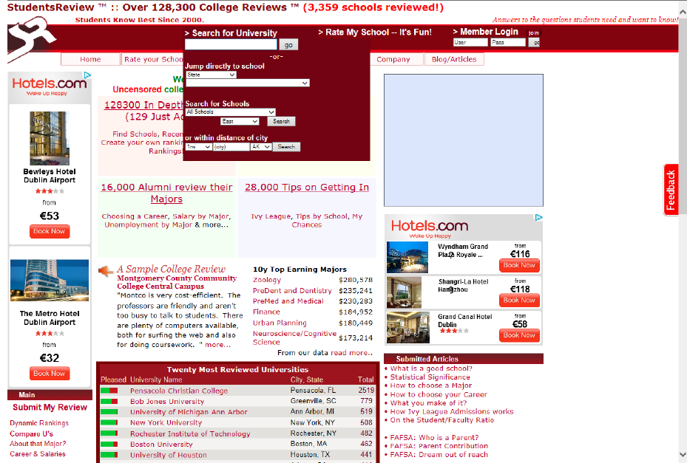
Student “TripAdvisor”
Notes:
Cross-jurisdictional comparisons remain but social-networking/new formats pose challenges for HE as it places control into user’s hands;
Student Trip-Advisor
Rate-my-professor
Student Review
Etc.

Slide 40
3. Implications for Higher Education

Slide 41
Shape of Things to Come
  Brief survey of recent developments shows what is coming down the track – what is happening internationally, and puts US experience in broader context.
HE has always been competitive, but it must now learn to survive in this more complex, and globally competitive environment in which:
        Quality and Excellence are key mantra;
        Greater public scrutiny and transparency are normalised;
        National prominence is no longer sufficient;
        Survival no longer guaranteed.
    There is likely to be a “savage sorting of winners and losers” (Sassen, 2011)
Notes:
See Francisco Marmeljo paper in Penang:
While elite benefit from public system, lower socio-economic groups are forced to pay fees at for-profit institutions.
In many developed countries, there is increasing differentiation between private, selective, research, elite universities and public, recruiting, teaching, mass HEIs. In other (developing) countries, the gap is widening between public, selective, research, elite universities and for-profit private, teaching mass HEIs. In other words, socio-economically disadvantaged or weaker students or students whose participation is restricted by life’s circumstances are forced to attend less resourced public or fee-paying for-profit institutions.

Slide 42
Would the Debate Happened Otherwise?
Academy has been slow to engage meaningfully in discussion about quality;
  Efforts at obfuscation, “gaming” and boycott have not helped;
      Too much emphasis on process;
      Complaints about excessive bureaucracy, form-filling, and cost of compliance;
      Pointed to the l’Oreal factor: because we’re worth it;
Information deficit has created opportunities for the public and governments – and commercial interests – to define quality for their own purposes.

Slide 43
Be Careful What You Ask For
    Public discourse in recent years has focused attention on:
      Meeting needs of national economies,
      Concerns about graduate employability and affordability
      Response to concerns about value and impact;
    Noticeable shift to measuring teaching and learning outcomes that allow public to judge whether graduates have the threshold qualities expected;
    Rankings initially filled this gap but they focus too narrowly on elite universities and research;
    Arguably – many of the new developments are a response to the over-emphasis on research rather than T&L.
Notes:
Calhoun (2006, 19) argues that public support for higher education is only given and maintained according to its capacity and capability, and willingness, to “educate citizens in general, to share knowledge, to distribute it as widely as possible in accord with publically articulated purposes”.

Slide 44
Start Driving the Bus
    Institutional and country-based evaluations are rapidly being overtaken by international efforts.
    Public/political support for universities and colleges only maintained by assurances of quality because society, students and others have a right to know whether the institutions are capable of meeting expectations.
  Little doubt that determining and measuring quality is complex;
    Lots of “good practice” but no agreed definition;
    Difficult to compare diverse institutions across jurisdictions;
  BUT – however worthy, criticisms of government/international efforts are – they miss the ‘politics’ of the situation.
  Challenge is how does HE respond? Can we afford to wait?
    If don’t cook own dinner – don’t complain what’s served to you.
Notes:
Calhoun (2006, 19) argues that public support for higher education is only given and maintained according to its capacity and capability, and willingness, to “educate citizens in general, to share knowledge, to distribute it as widely as possible in accord with publically articulated purposes”.

Slide 45
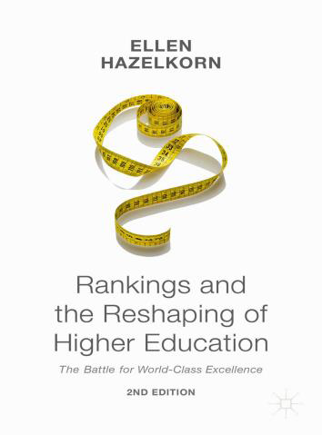
Higher Education Policy Research Unit (HEPRU)
Ellen.hazelkorn@dit.ie
http://www.dit.ie/hepru
https://www.researchgate.net/profile/Ellen_Hazelkorn
R

