Slide 1
130th NEASC Annual Meeting and Conference December 9-11 2015
Online Student Retention:
Data Driven Challenges and Strategies
Philip DiSalvio, Dean
College of Advancing and Professional Studies
University of Massachusetts Boston

Slide 2
Overview
The challenge of online learner retention
The research
A multivariate institutional approach
A data driven strategy to assist in a retention strategy
Implications
Recommended readings

Slide 3
The Challenge of Online Learner Retention
Despite steady growth of online learning, retention for online students tends to be lower than students in traditional, campus-based settings
Boosting online retention rates is fundamental in an accrediting environment that is increasingly demanding outcomes and results
Understanding factors contributing to online learner attrition essential for institutions who seek to formulate appropriate retention strategies
While many of the reasons students dropout are common to both modes of delivery there are issues unique to learning in the online environment
Online learning - It’s different
On ground
Online

Slide 4
Some of the Research
Tinto’s Student Integration Model (Academic and social integration with the formal and informal academic and social systems of a college)
Tinto's "Model of Institutional Departure" (Students need integration into formal (academic performance) and informal (faculty/staff interactions) academic systems and formal (extracurricular activities) and informal (peer-group interactions) social systems
Bean’s Model of Student Departure, Bean's Model of Work Turnover to Student Attrition (organizational attributes & reward structures affect student satisfaction and persistence)
Bean and Metzner's (1985) Nontraditional Student Attrition (environmental factors have a greater impact on departure decisions of adult students than academic variables)
Many of the variables in these constructs are not present in the online environment or they manifest in significantly different ways
Most influential models of retention were never meant to generalize beyond the traditional on-ground student

Slide 5
A Multivariate Approach An organizational culture of retention
Recruitment/Admissions
Retention starts here
Realistic expectations for prospective online students
Institutional Environment
Student experience with online courses starts before first log-on
Students must feel integrated into program & institution
Student Support
Infrastructure responsive to student needs
Accessible and available services especially geared toward students enrolled in online courses and programs
Faculty Support
Rigorous hiring and training procedures for online faculty
Support in in instructional design and ongoing support
Course Design
Design, format and delivery incorporating interaction, community and social integration
Relevant course content, high instructor presence, timeliness of feedback & continual involvement in the course community
Student Performance Tracking
Methodology to define and identify “at-risk” students
Provide students with appropriate resources and support
Track and monitor student engagement

Slide 6
Data Driven Strategies for Online Student Retention
A complex challenge that requires close coordination of several data-driven strategies
Insight into the student population is crucial - data mining can help spot students ‘at risk’ and tailor the interventions
Essentials in guiding a retention strategy – mine data – analyze data – intervene when necessary – follow-up on intervention
MINE DATA
ANALYZE DATA
INTERVENE
FOLLOW-UP
IDENTIFY
DATA

Slide 7
UMB Online vs On-Ground Retention Pilot Study An initial first step in identifying variations
72% (917) of the enrollments on-ground and 28% enrollments (354) were online
A total of 43 courses examined
29 sections on-ground 14 sections online
Total number of enrollments in all courses 1,271 students
Fall 2014 | Average Grade
Selected Courses | Online | On-ground
100 & 200 Level Courses | C+ (2.68) | B- (2.78)
 | [N = 194] | [N = 585]
300 & 400 Level Courses | B (3.07) | B (3.15)
 | [N = 68] | [N = 166]
 | p < 0.129
Fall 2014 | Completion Rates
Selected Courses | Online | On-ground
100 & 200 Level Courses | 71.2% | 80.2%
 | [N = 267] | [N = 721]
300 & 400 Level Courses | 81.6% | 88.5%
 | [N = 76] | [N = 174]
 | p < 0.0012
Courses with both online and on-ground sections
SPAN 101
SPAN102
ENVSTY 101
WOST 100
LATIN 101
COMSTU 105
ANTH 272
NURSING 314
SOCIOL 382
ECHD 440
Not a statistically significant difference in mean grade for online and on-ground courses
A more significant difference in the number of withdrawals from online courses
Completion rates are higher for on-ground courses.

Slide 8
Tracking Performance - One Model
Learning Analytics … the measurement, collection, analysis and reporting of data about learners and their contexts for purposes of understanding and optimizing learning and the environment in which it occurs
Tracking performance in understanding student persistence, learning, and success
Blackboard Analytics™ Model
A tool that tracks the performance of students, geared to improving student retention and optimizing student success

Slide 9
Data Analytics and its Potential to Increase Retention
Using analytics to …
Compare on the course-level HOW MUCH TIME students are spending online to identify areas where they might be struggling
Study PATTERNS OF STUDENT ENGAGEMENT and success and look for signs of students not engaging
SHARE WITH STUDENTS so they can track their own learning performance
Track student ACADEMIC PERFORMANCE and identify AT-RISK STUDENTS
Look for PATTERNS to explain why students drop out and develop interventions that address these obstacles
Evaluate the EFFECTIVENESS OF RETENTION PROGRAMS and adjust programs based on the findings

Slide 10
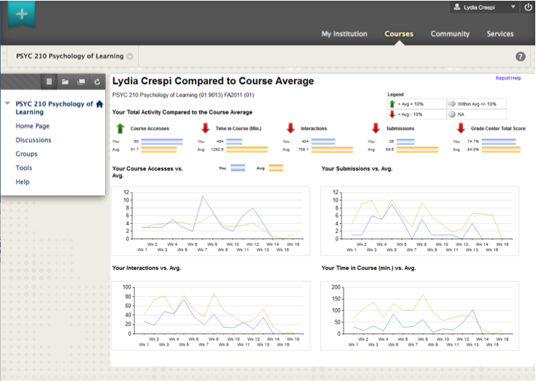
Student at-a-glance Bb Learn - Useful for an Advisor & for Student– COMPARATIVE TIME & EFFORT

Slide 11
Activity and Grade Matrix – A Report for Faculty Pictorial representation (Heat Map) of ‘Interactions’ and ‘Grade’ data four matrix indicators Inactive & Higher Grades, Active & Higher Grades, Inactive & Lower Grades, Active & Lower Grades

Slide 12
Business Intelligence Report – At Risk Students Grades are shown based on Instruction type – Hybrid, In-Person and Online Drill down on each of the elements to see a list of students that make up the data represented

Slide 13
Business Intelligence – Dashboard – Higher Level Course activity comparisons by average interactions

Slide 14
Course Metrics by Department Activity, interactions, time, submissions

Slide 15
Login Exception Report Students who have not logged in since a certain date and time Blackboard offers a service called “Student Services” where Bb will make the calls to students

Slide 16
Student At-a-Glance Report - Useful for an Advisor Grade may be low in one course …. or multiple courses – looking for patterns

Slide 17
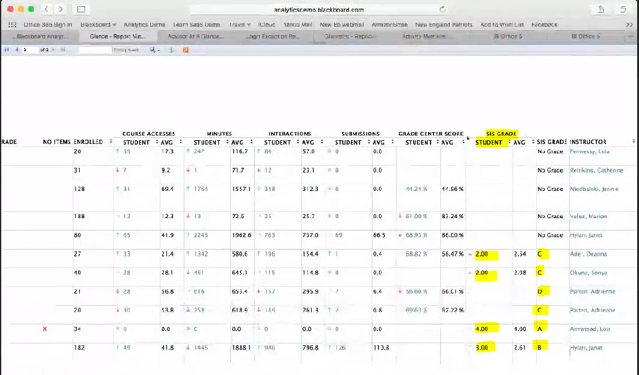
Grades Across All Courses Scores compared against the class average - red and green arrows show student performance compared to class average

Slide 18
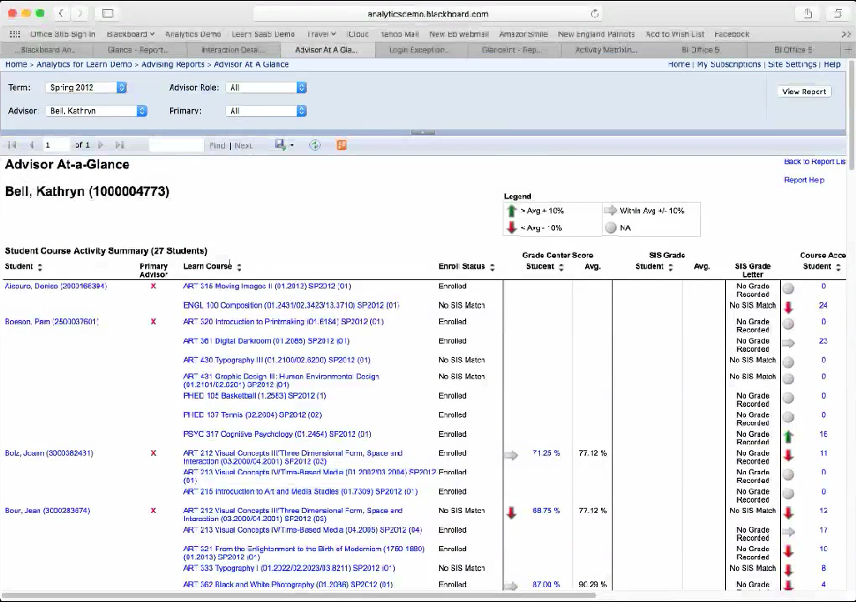
Advisor Report Status report for all advisees

Slide 19
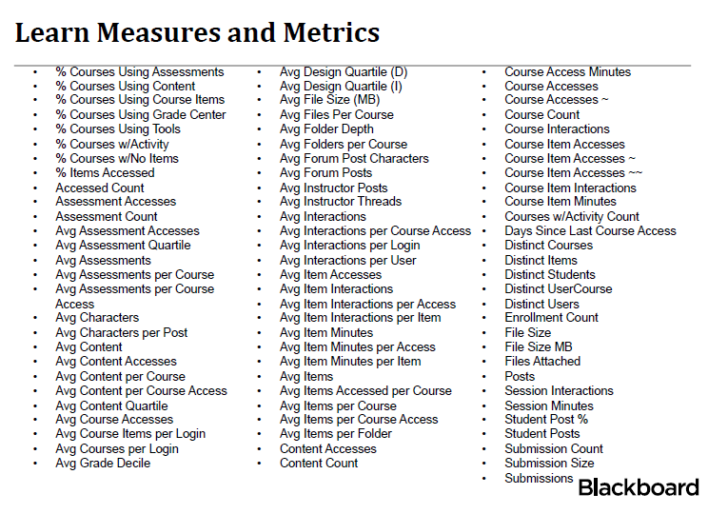
Raw Data Collected for Decision-Making For students at risk - for advisor - faculty - tutor

Slide 20
Implications -- Toward a Retention Culture
Student retention for the online student is a complex challenge
There are issues unique to learning in the online environment – with most or all of communication with students digitally mediated
There are institutional and pedagogical influences that affect online student retention
THAT REQUIRE
The commitment to a broad-based inclusive institutional infrastructure involving institutional policies, student and faculty support structures, and online course design
ACCOMPANIED BY
Close coordination of a number of data driven strategies

Slide 21
Recommended Reading
Poll, Kathleen, Widen, Jeanne, Weller, Sherrie. “Six Instructional Best Practices for Online Engagement and Retention.” Journal of Online Doctoral Education Volume I Issue I: (2014)
Picciano, G. “Big Data and Learning Analytics in Blended Learning Environments: Benefits and Concerns.” International Journal of Artificial Intelligence and Interactive Multimedia, Volume 2, Number 7: (2014)
Motivating and Retaining Online Students: Research-Based Strategies That Work by Rosemary M. Lehman and Simone C. O.Conceição. San Francisco: Jossey-Bass. (2014)
Boston, W. E., & Ice, P. Assessing retention in online learning: An administrative perspective. Online Journal of Distance Learning, Volume XIV, Number II: (2011)

