Slide 1
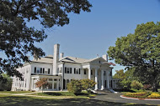
Albertus 2020: A Strategic Path for the 21st Century
Promote a diverse, inclusive learning environment by recruiting and retaining students, faculty and staff who reflect the demographic changes in our society.
Enhance student access and success through effective uses of technology, the development of flexibly delivered academic programs, and the implementation of high-impact practices.

Slide 2
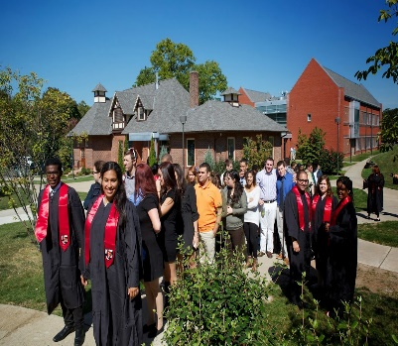
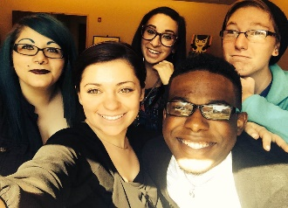
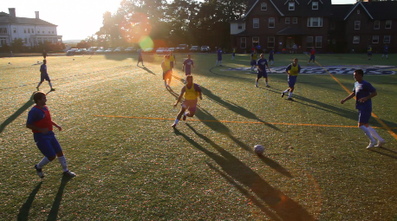
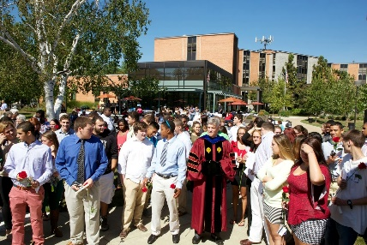
One Size Does Not Fit All: Addressing the Many Facets of Diversity at Albertus Magnus College
Traditional Undergraduate Program: 497
PGS Undergraduate: 692
PGS Graduate: 318
Female: 66%; Male: 44%
White: 40% African-American: 32%; Hispanic: 15%.
First Generation: 45%
Pell Recipients: 42%
Albertus Magnus College

Slide 3
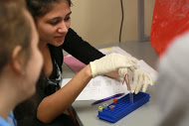
CTLE and the Focus on High Impact Practices
Establishment of the Center for Teaching and Learning Excellence: Coordination and Promotion of Academic Support Services
Accessibility Coordination Team
At-Risk Student Behavior Intervention Team
First year program
ePortfolio initiative
Peer tutoring
Experiential learning: student/faculty collaborative research; practica and internships; study abroad; service learning

Slide 4
Accessibility is Key to Success
1985: Inauguration of Accelerated Degree Programs
1994: Introduction of the New Dimensions Program
2009: Establishment of first fully online program
2015: Creation and implementation of the FLEX option

Slide 5
Assessment is Key to Success
Retention Rates
Black or African-American, full-time, first-time, degree/certificate seeking undergraduates: 70% (first out of 24 institutions)
Hispanic/Latino, full-time, first-time, degree/certificate seeking undergraduates: 50% (seventh out of 24 institutions; 3 institutions had 50% graduation rates)
White, full-time, first-time, degree/certificate seeking undergraduates: 58% (one of two institutions with the highest graduation rate among the 24 institutions)
Noel-Levitz Student Satisfaction Inventory
My academic advisor is knowledgeable about requirements in my major.
My academic advisor is approachable.
My academic advisor is concerned about my success as an individual.
The instruction in my major field is excellent.
Alumni Surveys
Alumni surveys show significant growth in interest to pursue further study from 2011 to 2014. Undergraduate Program alumni surveys show a growth from 9% to 39% of students planning to seek further education, and the percentage in the Accelerated Degree Program grew from 23.9% to 40%.
ETS Proficiency Profile
Growth in written communication.
Critical thinking is a challenge.
ePortfolio Assessment: Written Communication and Critical Thinking
Growth in written communication.
Critical thinking is a challenge.

Slide 6
Assessment is Key to Success
Effective use of Technology to Support Pedagogy
Enhancement of faculty training
Student orientation and remediation
Flexible Delivery of Academic Programs
Curriculum review
Implementation of best practices in course design
Student achievement of higher-order student learning outcomes
Refinement of student learning outcomes – focus on digital literacy and critical thinking.
Course redesign
Goal: Student Access Success and Retention

