Slide 1
College and Career Competencies:
Assessment and Student Learning
www.berklee.edu/institutional-assessment
Camille Colatosti. PhD
Presentation to NEASC National Conference
December 11, 2015
Notes:
Berklee assesses students on their college readiness upon arrival and works hard to place students in appropriate educational opportunities to help them learn and meet their goals. As well, we use direct and indirect assessment to improve the learning and student success, and to make changes to strengthen student readiness for careers. I will tell you what we are doing.

Slide 2
Berklee Mission
The mission of Berklee College of Music is to educate, train, and develop students to excel in music as a career.
Developing the musicianship of all our students is the foundation of our curriculum. We believe that the lessons and qualities derived from that work—the self-discipline needed for excellence, the empathy required of music making and the openness and inquisitiveness essential to creativity—are critical to achievement in any pursuit, musical or otherwise; and that music is a powerful catalyst for personal growth, which is central to any collegiate experience.
Notes:
Today
Who berklee is
How berklee approaches assessment
Direct assessment
Indirect assessment
Program review
Making strategic decisions based on assessment

Slide 3
Berklee Facts
Founded in 1945; accredited in 1973
Degrees: Bachelor of Music, Bachelor of Professional Studies, Master of Arts, Master of Music
Students
4500 in BM, 600 in BPS, 200 in Master’s
68% male, 32% female
34% international, 66% domestic
8% African American, 5% Asian American, 12% Hispanic, 7% Mixed race, <1% Pacific Islander, Native American
Notes:
Berklee, until 2012, only one degree--in boston, BM; lots of change and growth since then--master’s, international campus, BPS online, merger with The Boston Conservatory, Founded in 1876, 820 students, 38% male, 62% female, 70% undergrad, 30% master’s

Slide 4
Berklee’s Office of Assessment
Provides guidance and support for every area of Berklee to engage in continuous, comprehensive research and self-evaluation, gathering the information required for data-driven decision-making, policy development, and strategic planning
Design and execute assessment plans, surveys, and focus groups
Direct and indirect assessment
Advanced analysis and interpretation of data
Benchmarking of Berklee with peer institutions
Accreditation/Compliance
Notes:
Camille’s slide.
compliance reports--government requirements, accreditation, and more
Questions berklee has about itself--student success, what alums are doing, etc.

Slide 5
Berklee Approach to Assessment
Data-Driven Decision Making
Focus on measurable outcomes
Develop or modify systems to collect relevant data
Integrate assessment into academic and operational activities
Assessment Committee
Notes:
Changes in business world and higher education, more focus on metrics - BIG DATA
Rankings are more important since US News started, Obama’s scorecard
Dept of Ed tracks more data, important for financial aid
Accreditation standards stress quantitative measures (vs. anecdotal evidence).
Data are everywhere, we can help design ways to capture and analyze for the most benefit
About planning well before,
(a)the outcome should be measurable, hard to take a goal and make it measurable. how can you measure better team cohesiveness, improved analytical thinking. e.g an increase in graduation rates, increased usage of a service your department offers.
(b) plan well initially so that the data being collected is relevant, the data you want. Don’t collect everything, signal will be lost in the noise.
(c) taking a step back periodically to see where you can integrate some assessment. could be something easy and small, e.g. library.
(d) AC- college-wide committee meets monthly whose charge is to support and guide the collection and sharing of data and the ongoing assessment of every aspect of the college's mission.

Slide 6
Direct Assessment
Pre-matriculation
Instrumental Rating
Music Theory Assessment
English Language Proficiency
Scope of Selected Institutional Assessment Projects
Assessment of Classroom Learning
Instrumental/Vocal Proficiencies
Assessment of Experiential Learning
Notes:
pre-matriculation--rating on instruments, music theory, English proficiency;
instrumental proficiencies at the end of each semester;
Assessed in audition/interview on
academics
musicality
Assessed before classes start on
vocal/instrumental proficiency
music theory
English language (for second language speakers only)

Slide 7
Program Review
Curriculum Review Initiative
Mission-focused
Faculty/student focus groups
Scope of Selected Institutional Assessment Projects
Alignment of outcomes/assessment
High-risk courses, DFW rates
Institutionalized formal 3-year program review
Notes:
Curriculum Review Initiative--first comprehensive overhaul of curriculum
How are we reaching the mission
2006-10
Focus groups faculty and students
Student pass/fail--DFW rates
What are we doing and what is missing
Formal program review and 3-year cycle
questions
process
changes

Slide 8
Revisions Based on Program Review
Developmental education
English composition
Music theory
Career focused education
First-semester seminar
Junior seminar
Scope of Selected Institutional Assessment Projects
Alignment of outcomes/assessment
Diversity focus
New programs
Notes:
Changes
Developmental
Removed developmental courses
English--only 10%, not effective
Music theory--70%, such a high percentage no longer developmental
English instruction mainstreamed--success
no change in pass rates
Music theory--revised course integrated developmental and level one, added credits (4 hours now)
pass rate increased by 50%, from a 25% dfw to a 12% dfw
Career
Added career-focused preparation
LHUM-100 (summarize)
LHUM-400 (summarize)
Diversity
Diversity/inclusion office
Cultural leadership training
international campus/study abroad
Advanced study
Added master’s programs
one year
tailored
small cohort
graduate rate -- effectiveness
career and internship work

Slide 9
Indirect Assessment
Peer Comparison Report
Alumni Survey
Faculty/Staff Survey
Scope of Selected Institutional Assessment Projects
National Student Surveys (i.e. NSSE)
Course Evaluations
Student Satisfaction Surveys
Notes:
Peer comparisons: Using consistent data measures from a group of schools to compare Berklee to others.
Another part of IA is the ability to make comparisons. a range of metrics such as demographics, graduation, retention rates, institutional characteristics,financial aid… Are we typical of the rest of the peer group? atypical? in what ways and what does it mean?
Helpful to see how we are doing year to year ourselves and also in reference to the other schools.

Slide 10
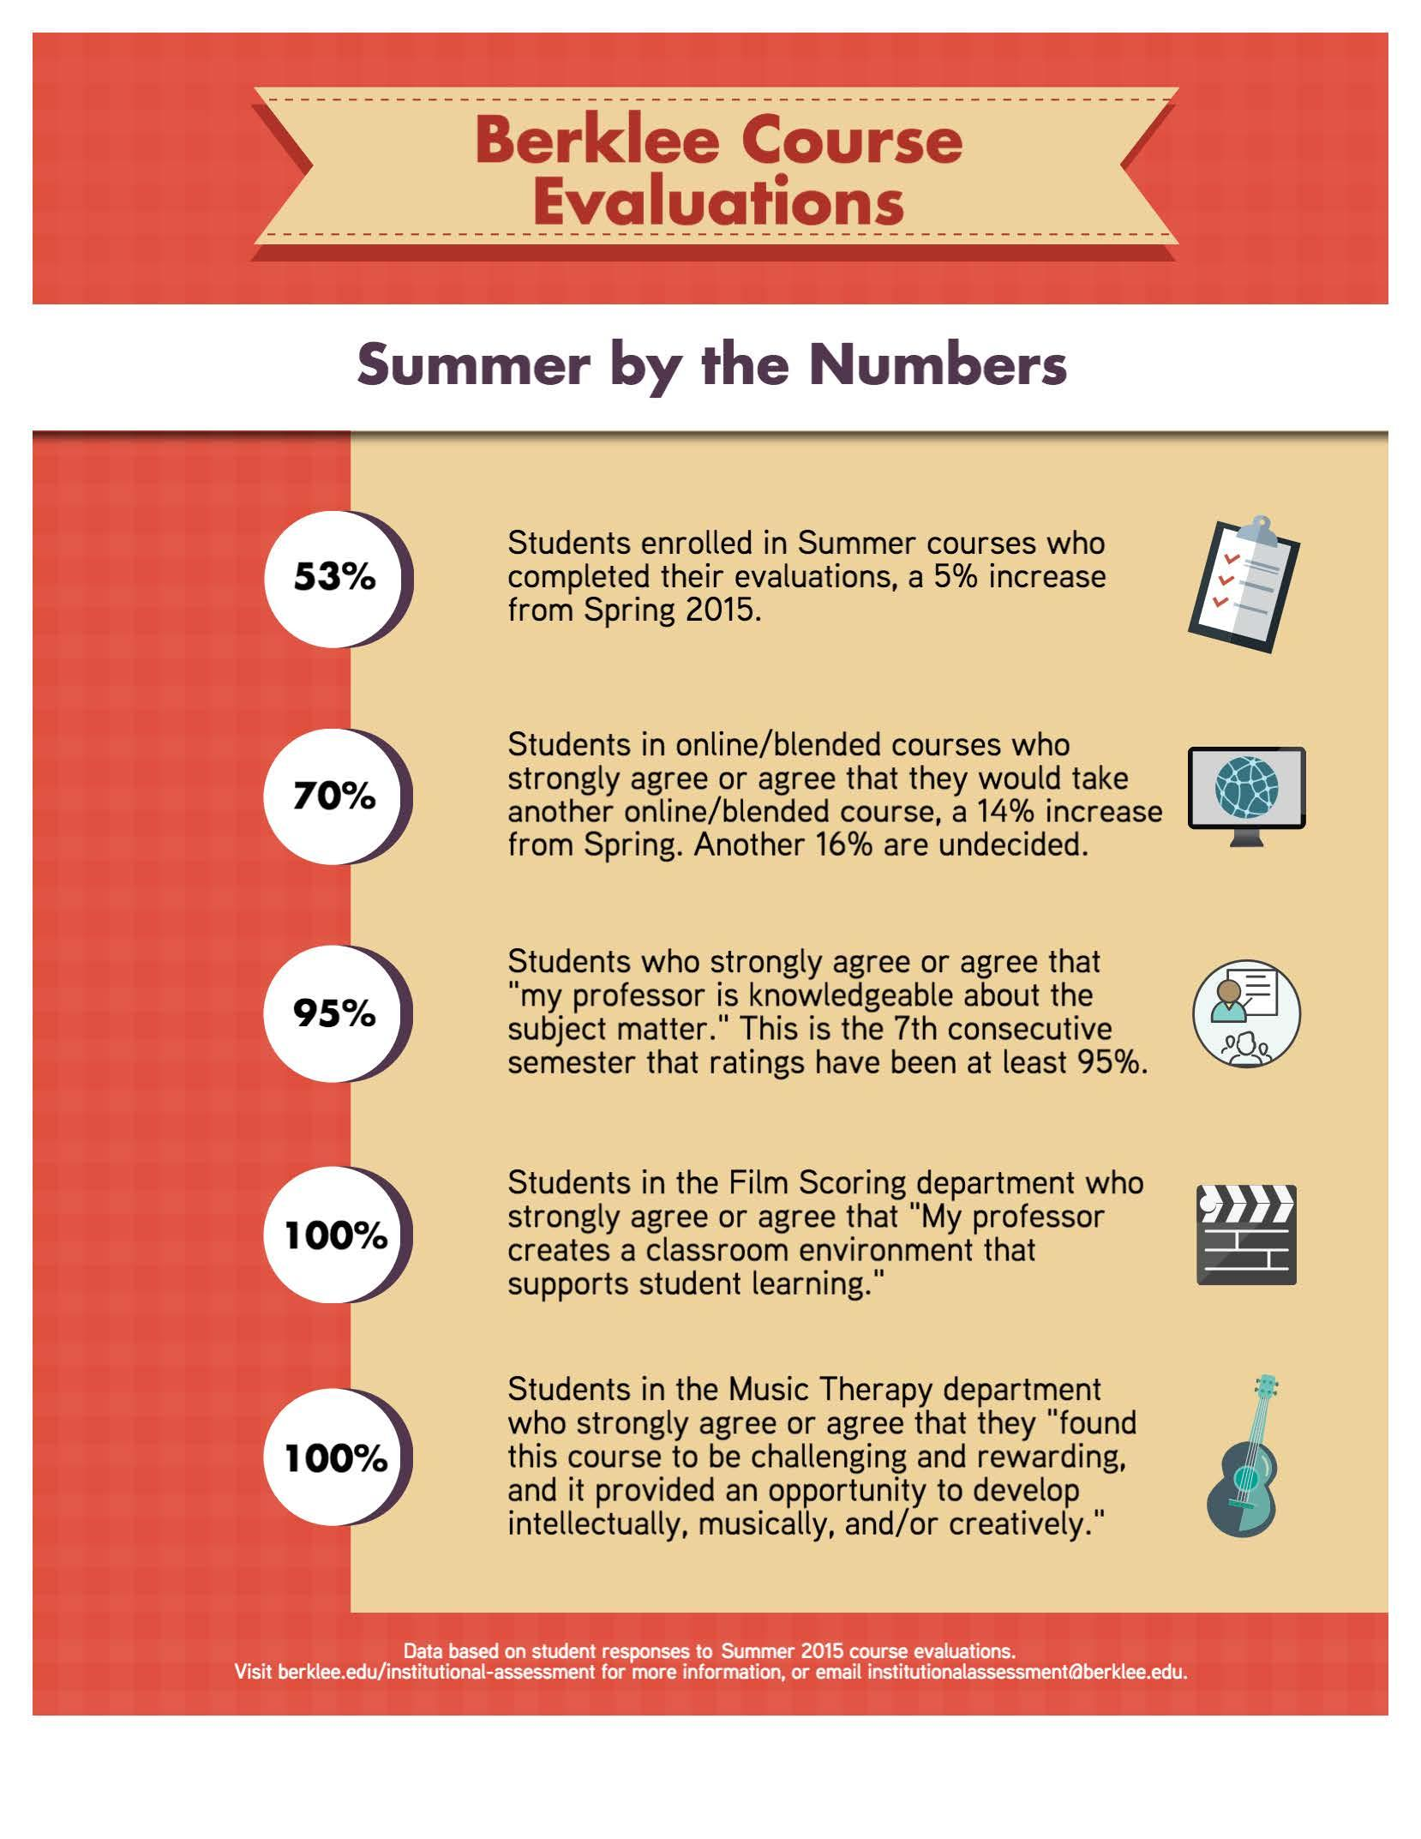
Course Evaluations
Convened student and faculty focus groups to improve both
the evaluation process
the actual surveys
Increased evaluation frequency to every semester
Response rates over 50%
Useful reporting of results
Notes:
Assessed course evaluations to improve response rates, how to make the process better for the students, more useful, more relevant, and thus more reliable data for faculty, chairs, deans. Students like the chance to talk about the courses.
How to make the data most clear, concise and useful to faculty and chairs.
Overall results available on our website.

Slide 11
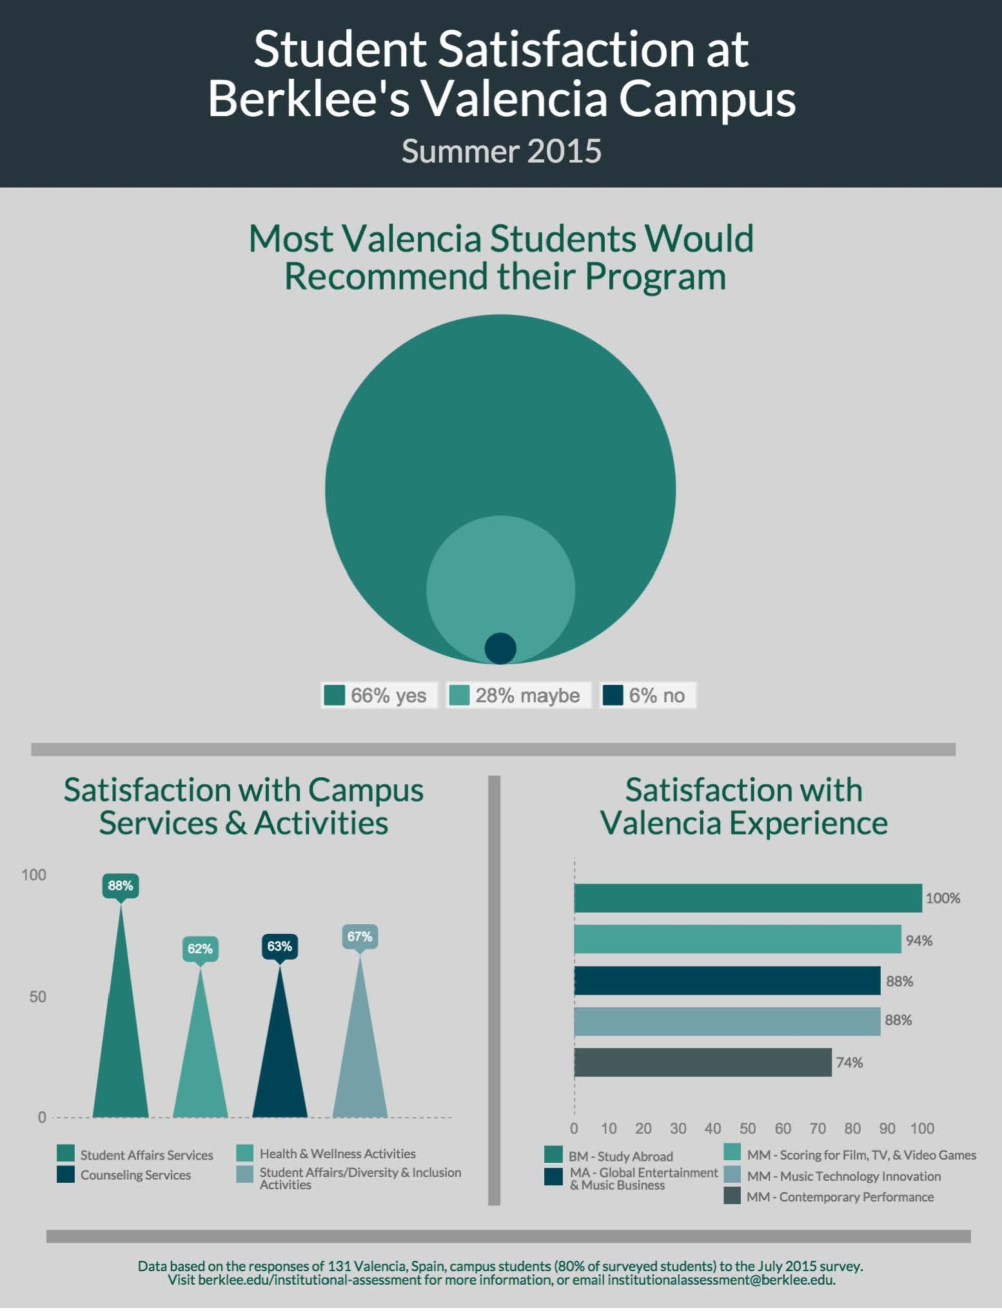
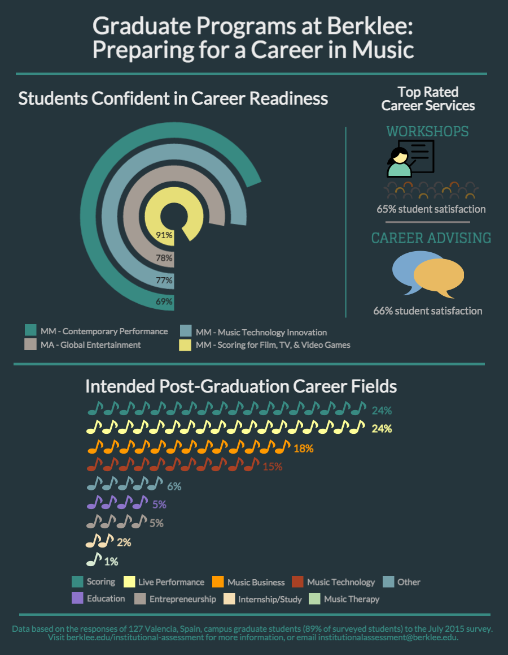
Valencia Student Satisfaction
Notes:
Opened international campus for study abroad undergrad and masters
survey each semester
high satisfaction
assessment of their career readiness

Slide 12
How well did Berklee prepare you for the future (On a scale of 1-4…)
How Much Confidence do you have in your ability to complete tasks requiring:
To what extent has your coursework in your major(s) emphasized the following?
Critical thinking and analysis of arguments and information | 3.7
Creative thinking and problem solving | 3.6
Research skills | 3.4
Clear thinking | 3.2
Persuasive speaking | 3.2
Technological skills | 3.3
Financial and business management skills | 2.8
Entrepreneurial skills | 2.8
Leadership skills | 3.3
Networking and relationship building | 3.1
Generate new ideas or brainstorming | 3.4
Taking risks in your coursework without fear of penalty | 3.0
Evaluating multiple approaches to a problem | 3.2
Investing new methods to arrive at unconventional solutions | 3.1
To what extent have courses in your major prepared you for your post graduation plans:
3.4
Notes:
From NSSE--career preparation

Slide 13
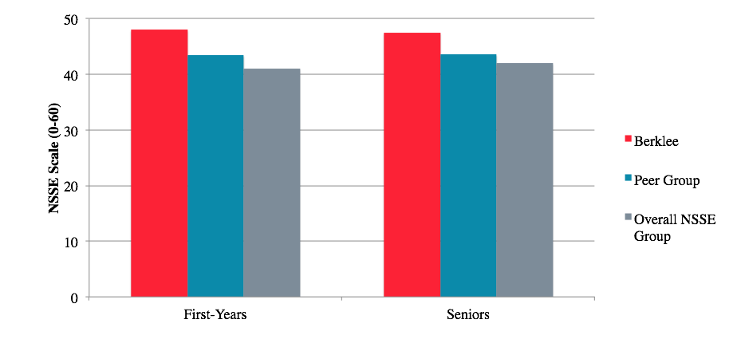
Diversity
Berklee Students Are More Engaged With Diverse Groups than Peers
Notes:
From NSSE--diversity
Emphasis on diversity yielded some results, from NSSE data
Discussions With Diverse Others: Berklee First-Years were more engaged than the peer group in the frequency of having discussions with people from a race, ethnicity, economic background, religious belief, political view other than their own. Seniors were also more engaged than the peer group on this measure, and more engaged than the overall NSSE group as well.

Slide 14
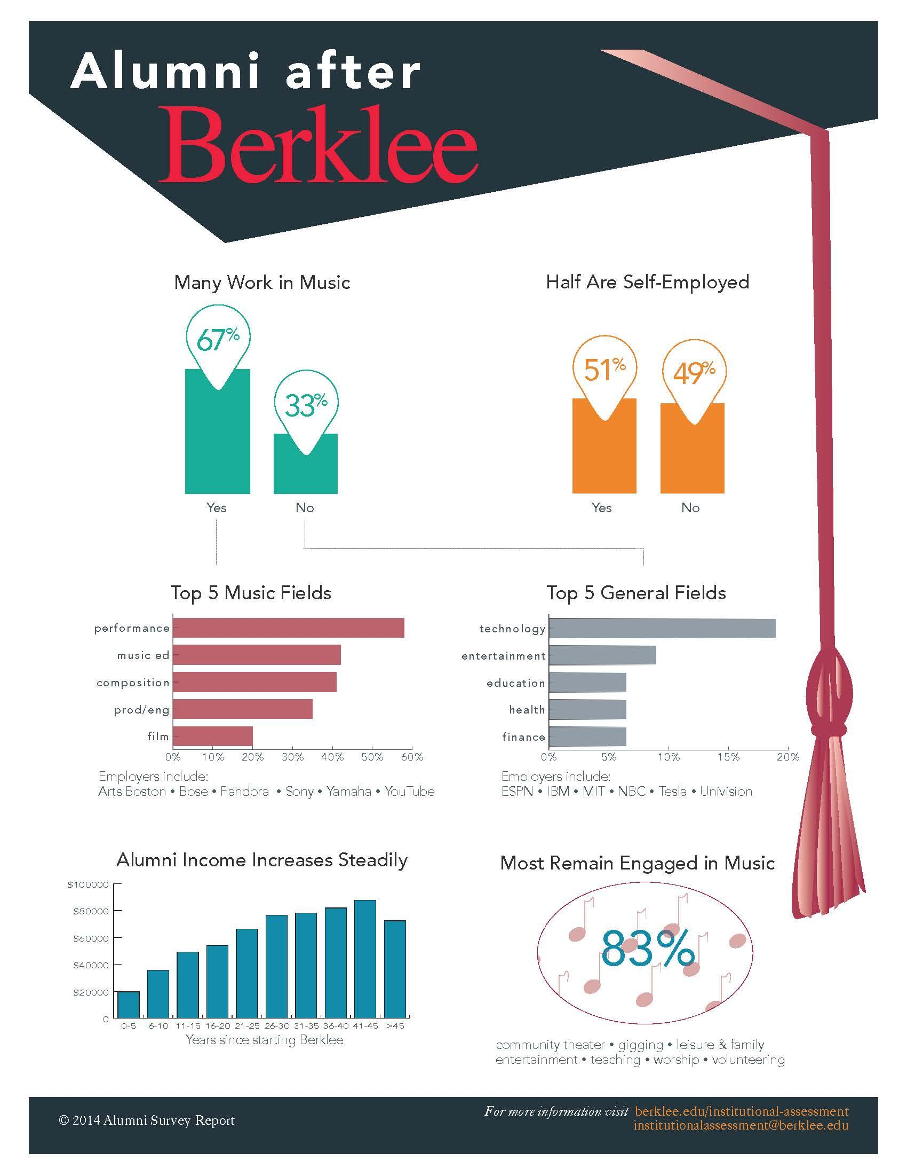
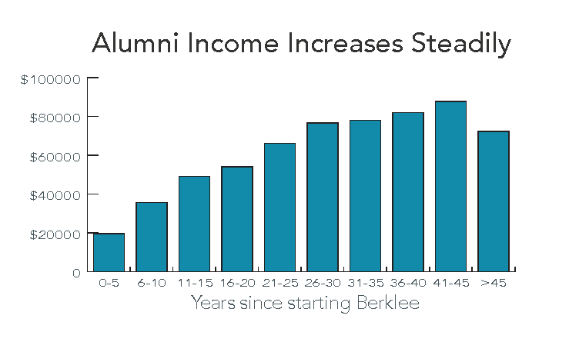
Alumni Report
Notes:
Every 2 years. how doing incomewise and in music
Key metric for government and for us
Engaged in music
Seeing income increase steadily

Slide 15
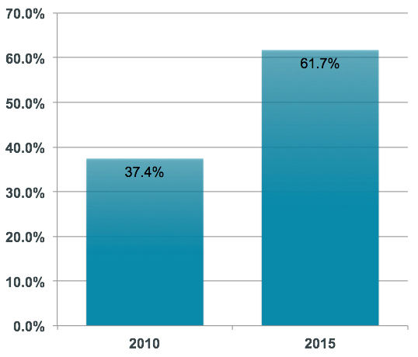
Faculty & Staff Survey
Collaboration with Human Resources, Faculty Development
Last survey done in 2010
Redesigned survey
Questions specific to faculty
Innovative survey tool introduced
Survey Response Rate
Notes:
redesigned to be more scientifically sound, added faculty-specific questions.
most important: introduced new survey tool to ensure confidentiality, accessibility, functionality

Slide 16
Strategic Planning and Assessment
Mission Review
Merger - The Boston Conservatory
Academic Programs
Mix of undergrad, grad, online
Scope of Selected Institutional Assessment Projects
Affordability Initiative
Degree Completion
Notes:
Future planning--data driven
Mission review--key with merger with boston conservatory
Striving to look at how to make undergrad more affordable
articulation agreements
advance placement
summer term
Degree completion program--to bring more people to graduation (about 50% right now)
students within 30 credits of graduation, outreach to them, combination of online and bm onground

Slide 17
Comments, Questions, Suggestions
Thank you

