Slide 1
Three Independent Leaders Swap Place: Valuable and Unanticipated Lessons Learned
Mary Frances Bisselle
Trudy Hall
Karen Gross

Slide 2
Introduction
Context
Writing Exercise
Pair-Share
Discussion
Questions
How can an exchange like this lead to practical improvements?
How could this swap be replicated?
What suggestions do we have for the accreditation process?

Slide 3
Swapping Places
http://www.nais.org/Magazines-Newsletters/ISMagazine/Pages/Swapping-Places.aspx

Slide 4
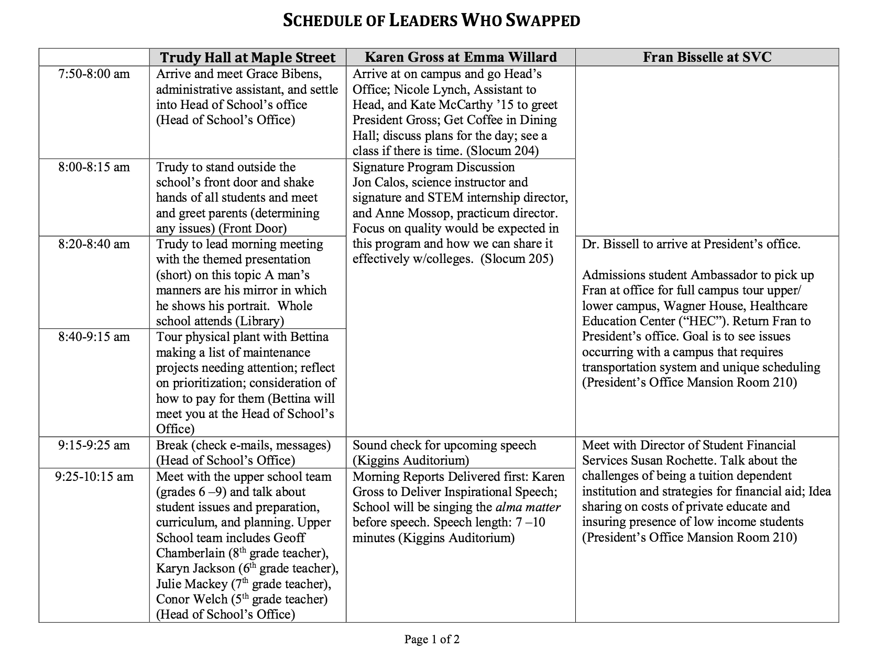

Slide 5
Schedule of Leaders who Swapped
http://www.nais.org/Magazines-Newsletters/ISMagazine/Documents/Swapping%20Places%20ISMfall2015.pdf

